Slide 1
State of the Birds in Nevada

Slide 2
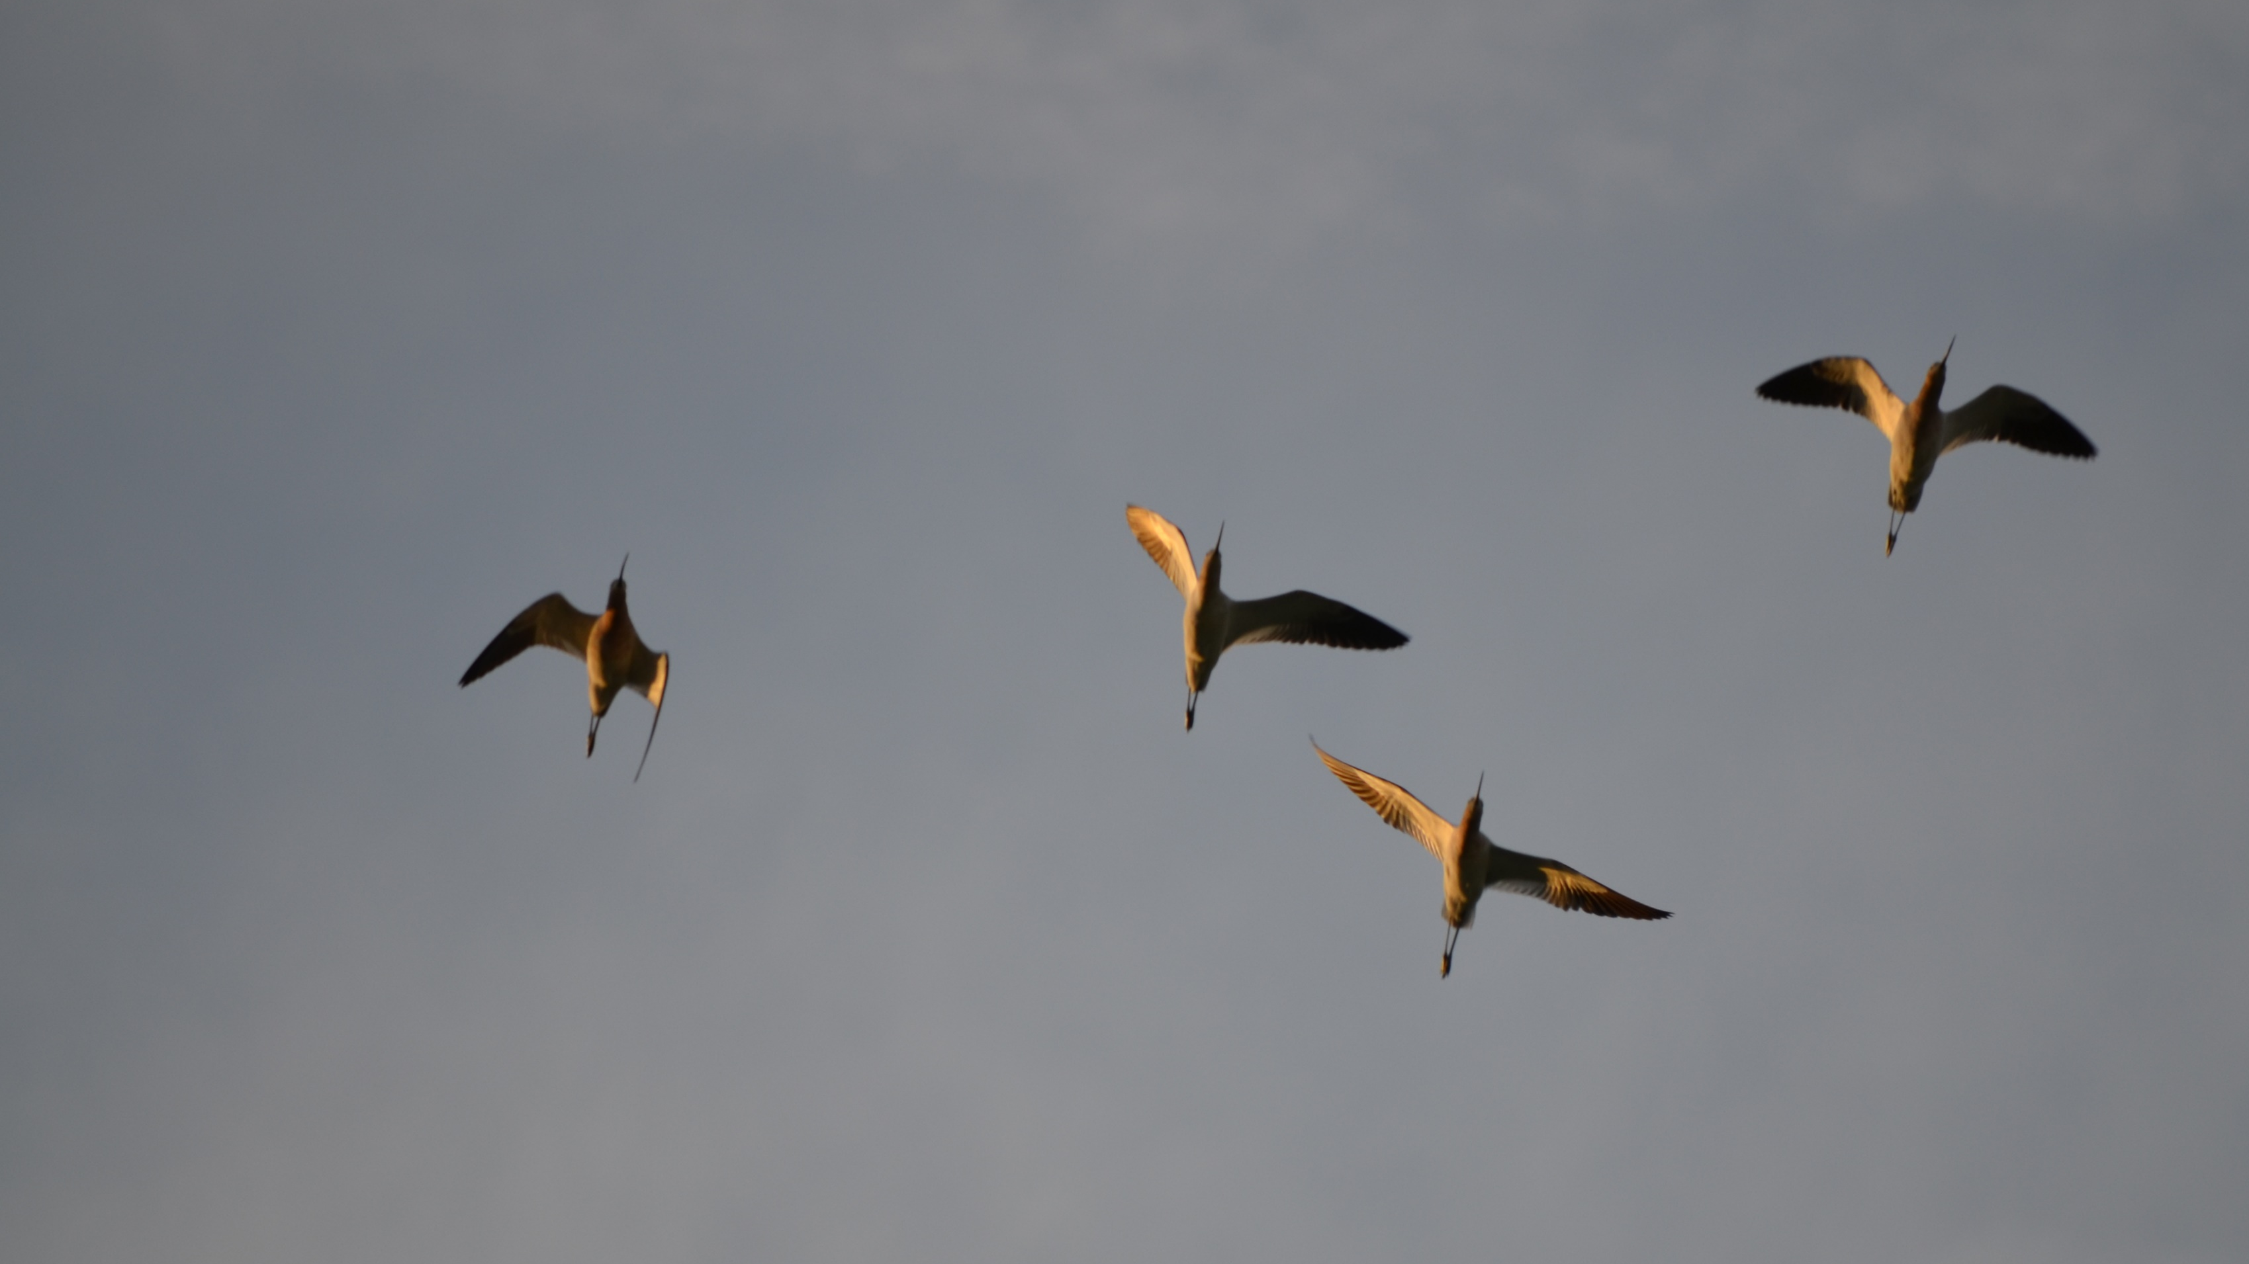
SWAP update
Nevada’s State Wildlife Action Plan has been revised on its 10-year schedule. It now contains 75 bird species classified as species of greatest conservation need (up from 60).
Additions:
15 passerine/near passerines
2 owls, 2 raptors
1 shorebird, and 2 waterfowl
Edits:
1 passerine was subdivided taxonomically with only 1 of the newly designated species retained
Removals:
2 shorebirds, 2 water birds, 1 waterfowl
1 hummingbird
1 crane

Slide 3
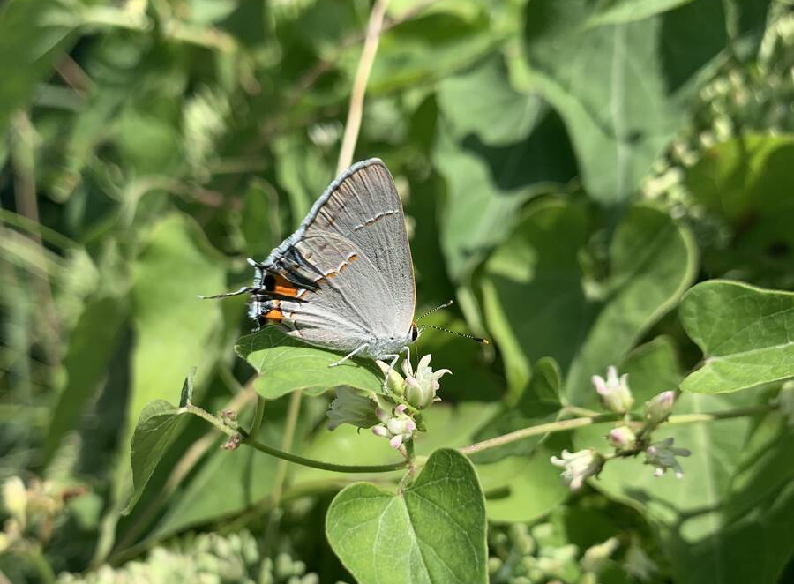
SWAP update
The 2022 SWAP now contains the inclusion of terrestrial pollinator invertebrates underneath the definition of wildlife.
This gives NDOW the ability to manage them as such and NDOW plans to designate a staff specialist to this role in the future.

Slide 4
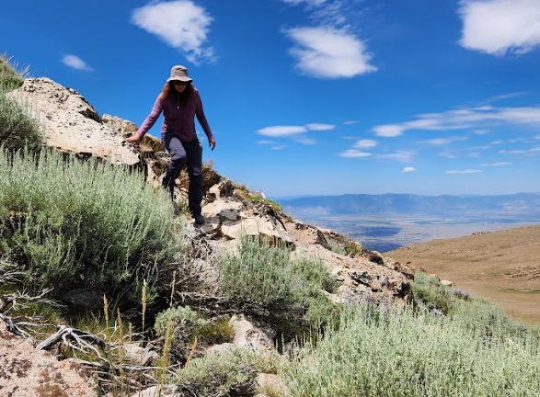
SWAP update
The 2022 SWAP now incorporates updated climate change information and reorganized key habitats throughout the state.
This includes a regional coordination component with adjacent states to manage consistently across borders.

Slide 5
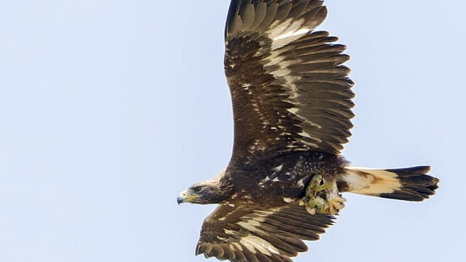
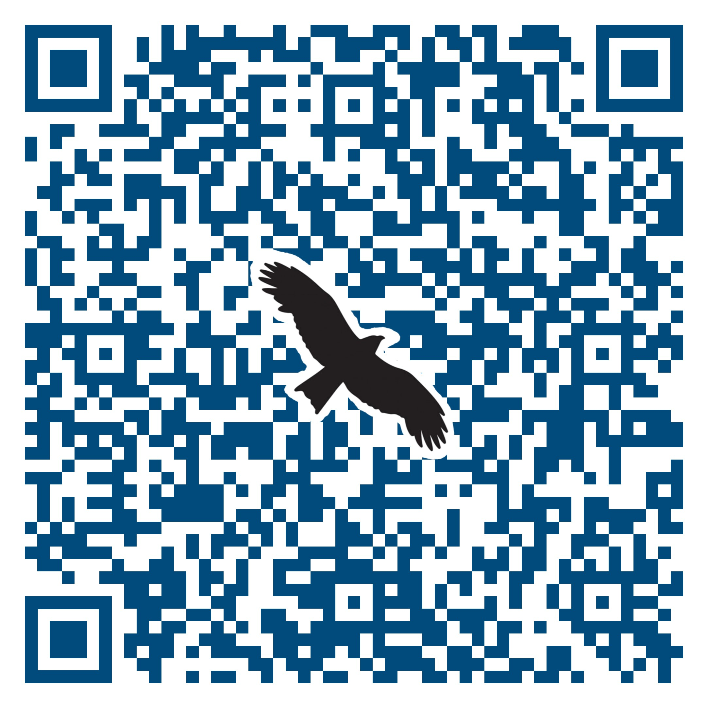
Golden eagle permit
In August, Nevada Legislative Commission approved proposed regulations to allow possession of golden eagles with the use of an eagle permit issued by NDOW.
This will allow licensed Master Falconers to posses a golden eagle and allows for falconers and rehabbers to work closer together.

Slide 6
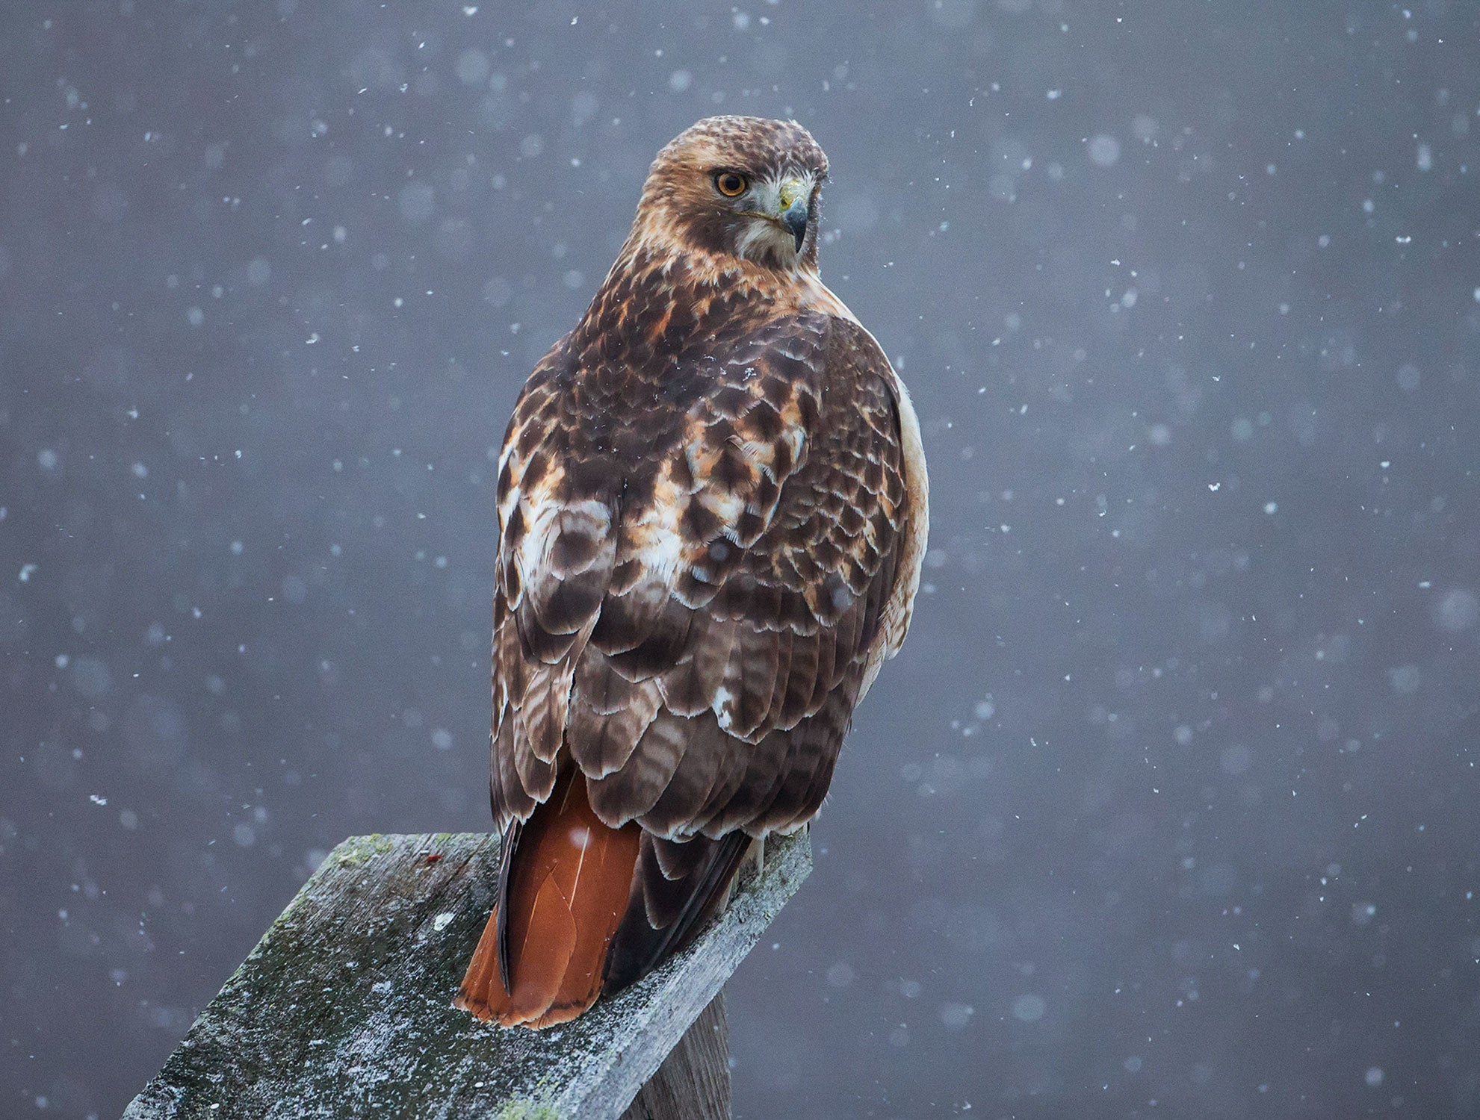
Winter Raptor Long-term monitoring

Slide 7
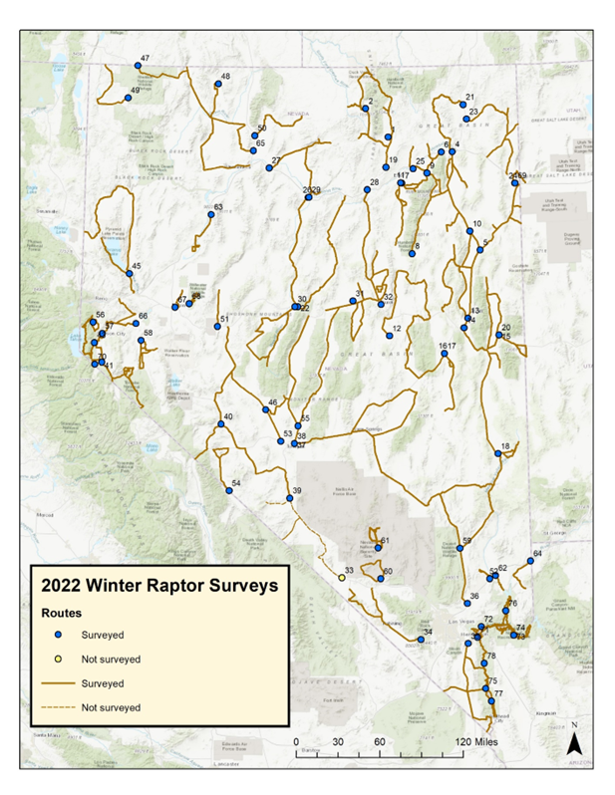
Winter Raptor Long-term monitoring
Monitored winter raptor activity of 50 years during the entire month of January
Consists of 76 established routes throughout the state
Consistently gets more than 1,000 observations with the assistance of staff and dedicated volunteers

Slide 8
Winter Raptor Long-term monitoring
Monitoring seasonal usage by raptors allows data to be collected toward:
Identifying important wintering areas for raptors
Monitoring modifications or threats to these sites
Providing information on both breeding and nonbreeding segments of the population at a potentially limiting time of the year
NDOW plans to continue surveys as usual through January of 2024, and hopes to conduct another 5-year deep dive data analysis in 2024.

Slide 9
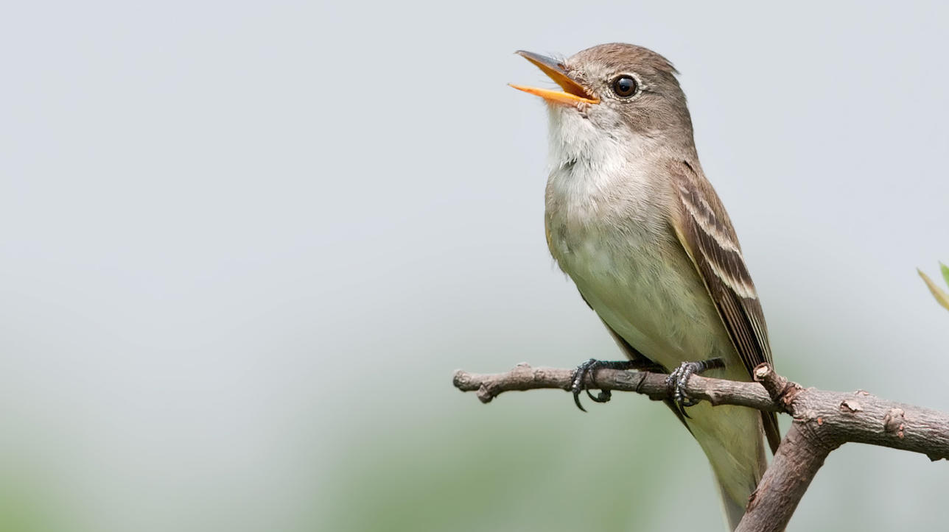
Threatened & Endangered birds surveys
NDOW has focused on monitoring endangered species Southwest Willow Flycatcher, Yellow-billed cuckoo, and Yuma ridgeway’s rail in the past, and is anticipated to focus on them in the future using traditional and new/varied techniques
Call-broadcast surveys & nest detection
Acoustic detection

Slide 10
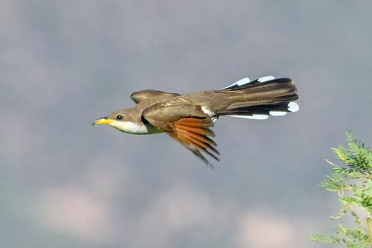
Yellow-billed Cuckoo
NDOW and the Utah Division of Natural Resources provided results of the yellow-billed cuckoo data into FieldMaps

Slide 11
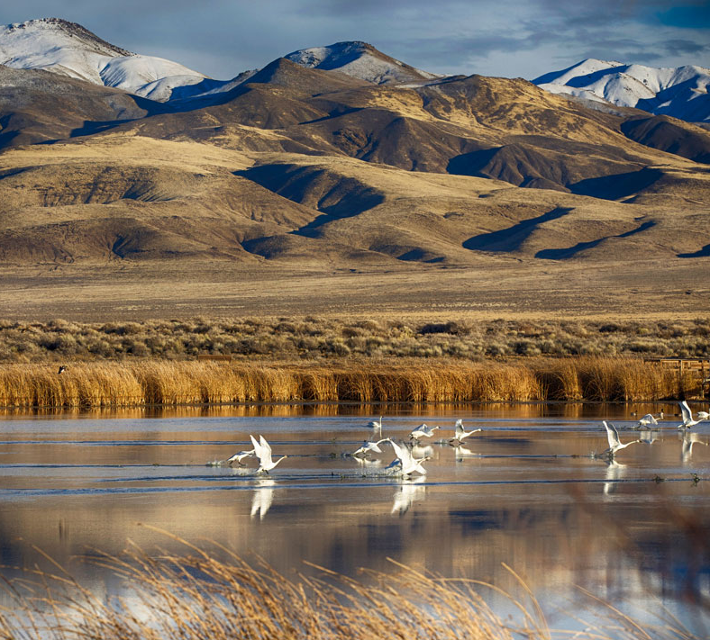
Shorebird biannual surveys
Participating in the Intermountain West Shorebird Surveys with Point Blue Conservation Science and 11 other states
Nevada has 57 historical sites and has counted over 21,300 shorebirds
NDOW provided 12 staff, 61 volunteers, and partnered with local Audubon chapters, federal and local governments, and volunteer groups

Slide 12
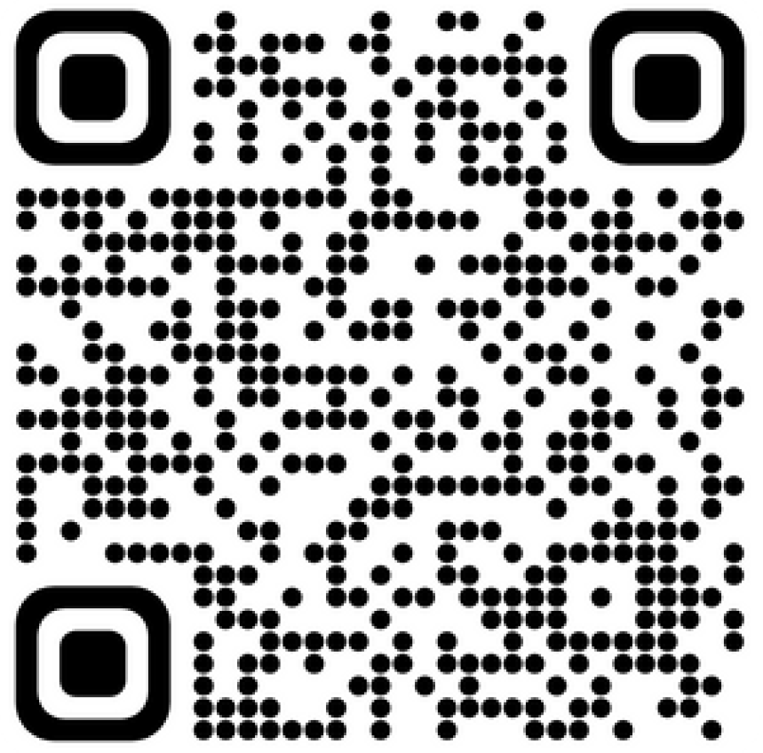
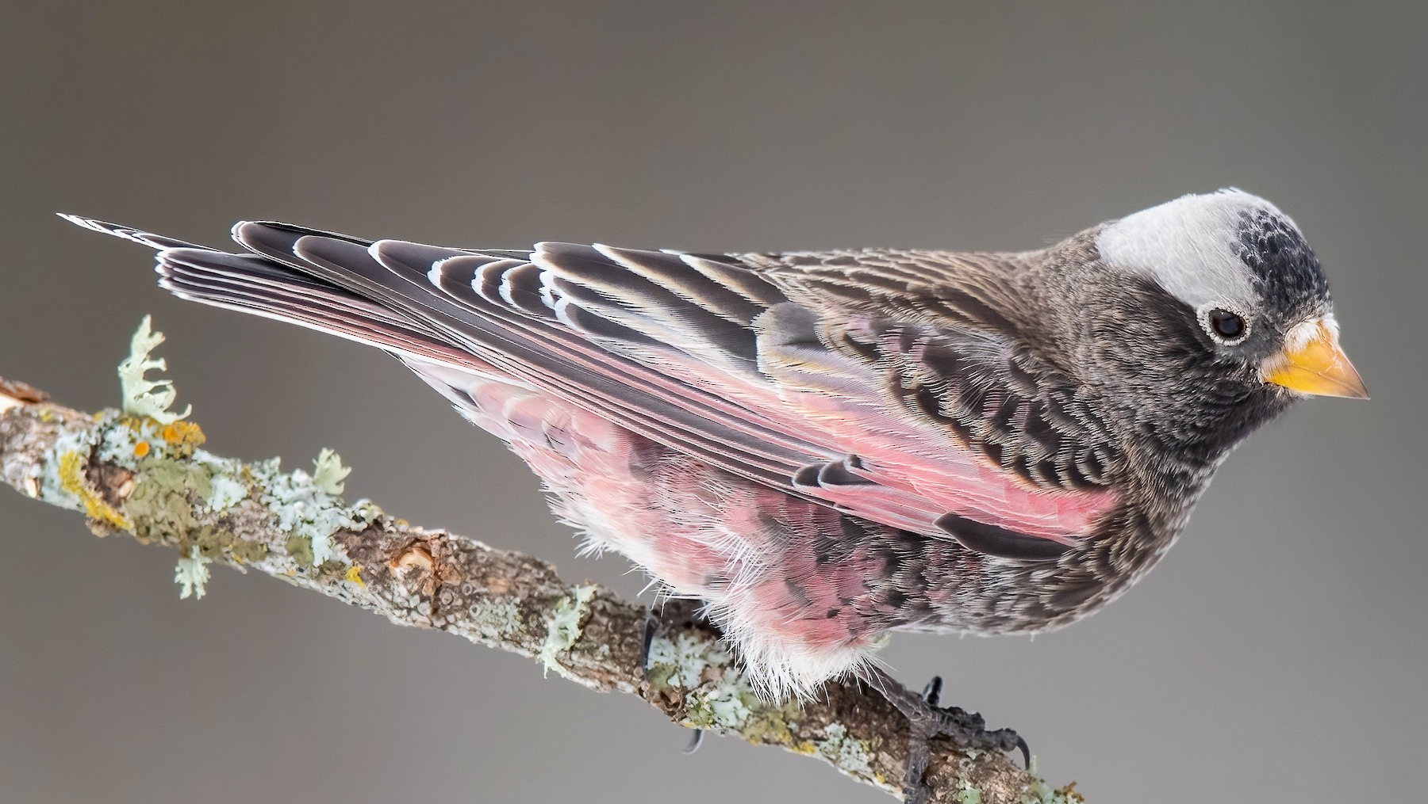
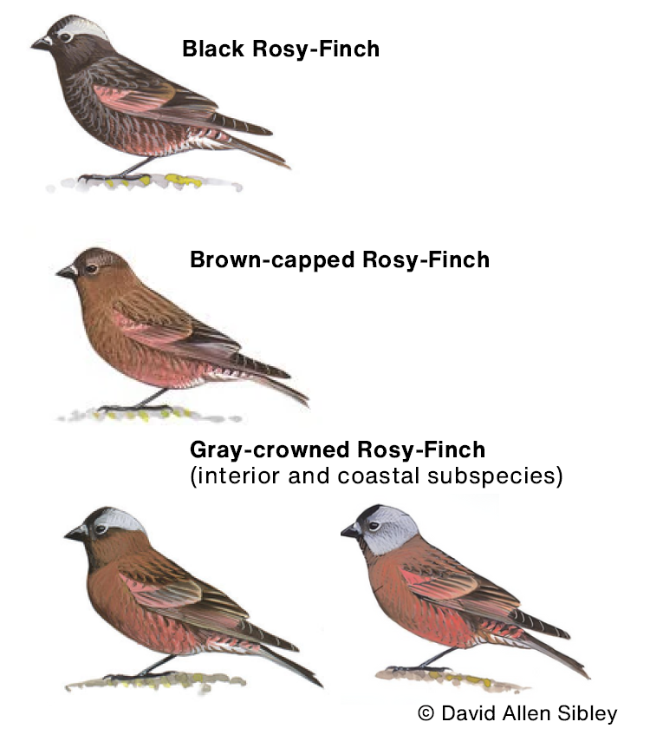
Rosy Finch Counts
Incidental observation report the working group created with the help of Utah – the more observations the better!

Slide 13
QUESTIONS

Slide 14
Community Science update –
Nevada Wildlife Discovery Trail

Slide 15
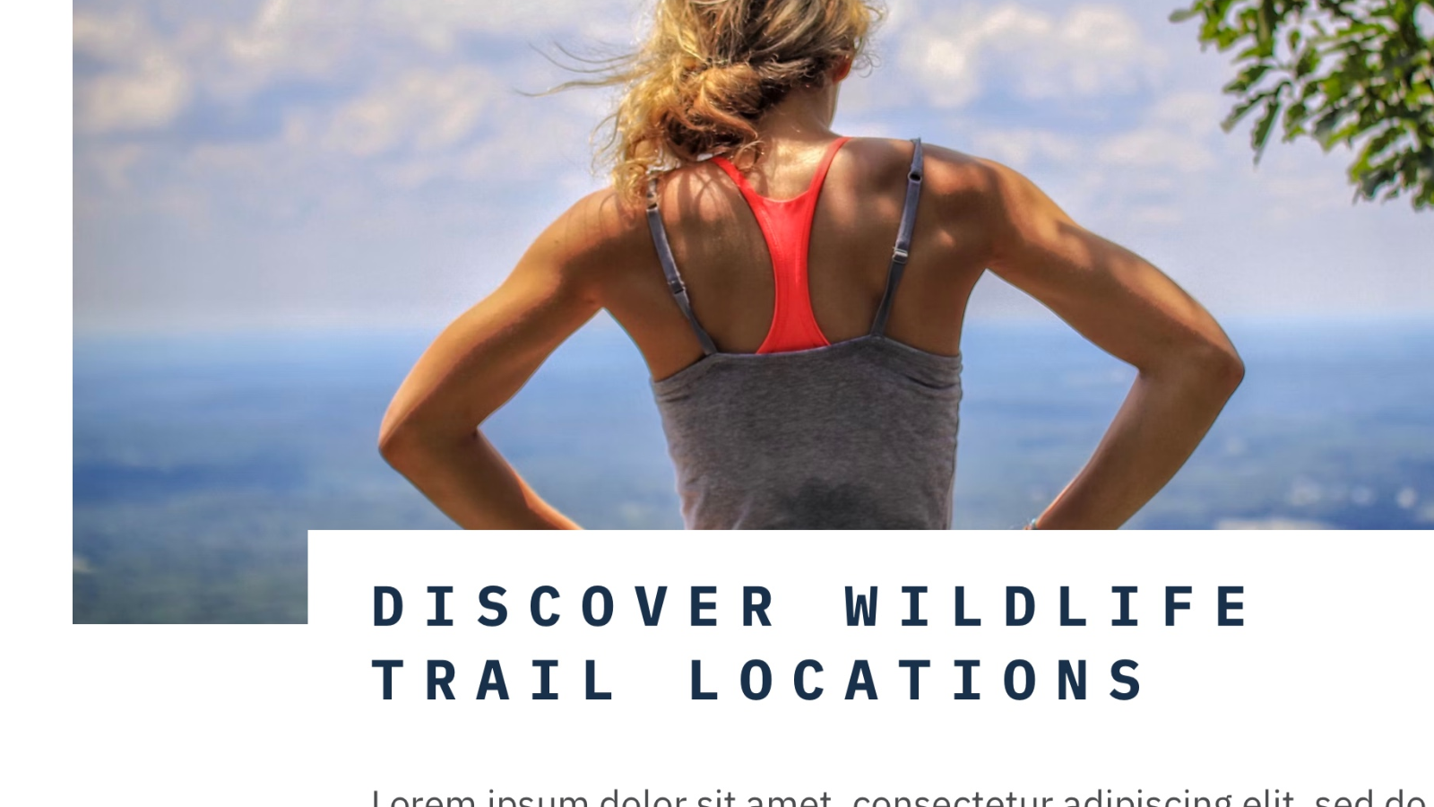
Wildlife Discovery Trail
OVERVIEW
Virtual view of all wild locations throughout the state, spotlighting government and local partner sites, activities available, and must-see wildlife
Finalized 1-year and 5-year plans for roll-out
Now have 3 dedicated staff
Most partners have responded to data-gathering forms
Presenting at the 2024 Wildlife Viewing and Nature Tourism Conference in February

Slide 16
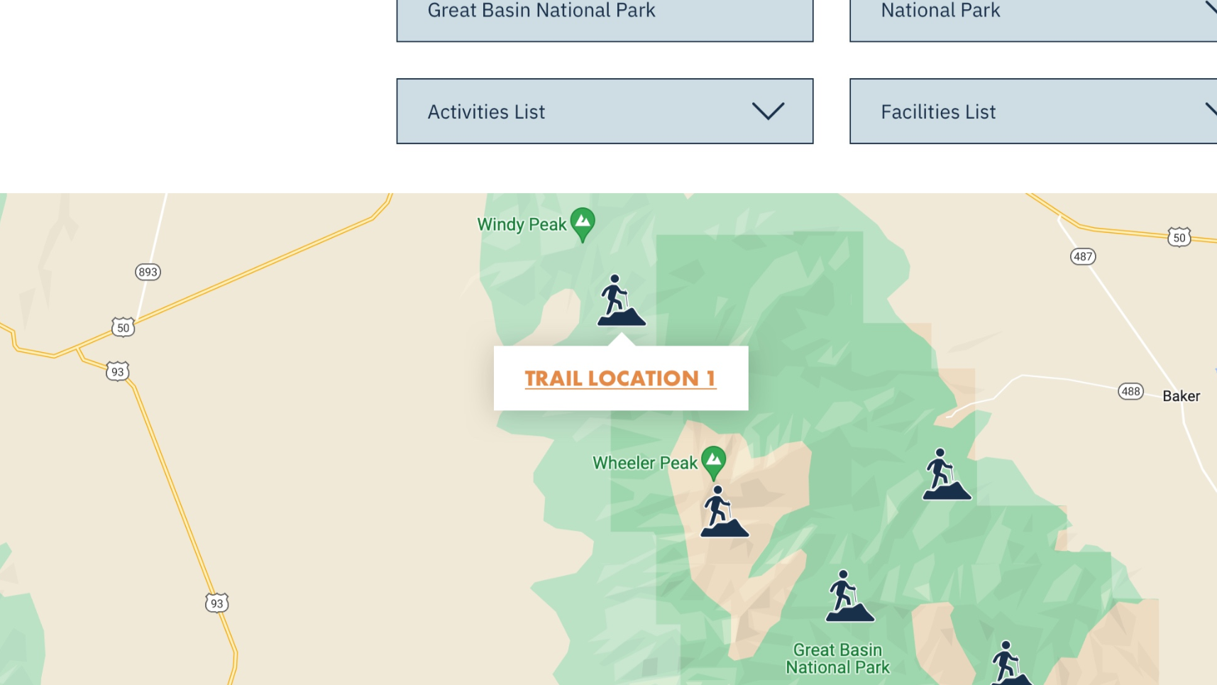
Wildlife Discovery Trail
WEBSITE IMPROVEMENT
Working with the Abbi Agency to design webpages with interactive maps and activity selection options
Complete location page roll-out is planned in 3 phases (by region) – Phase 1 (Eastern Region) will go live by the end of the fiscal year
Will include partnering locations from US National Park Service, NV State Parks and Recreation areas, Wildlife Management Areas, County public trails and reservoirs, wilderness study areas and refuges, and local urban parks

Slide 17
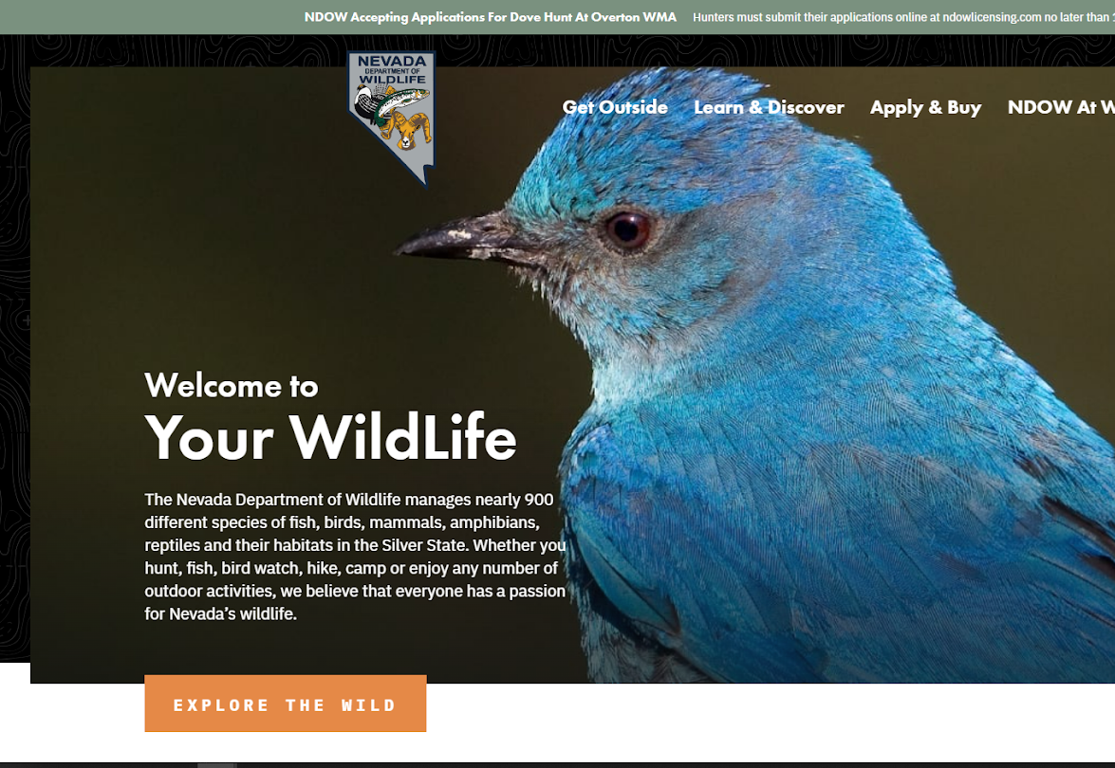
Wildlife Discovery Trail
WEBSITE IMPROVEMENT
Species cards are live online with more species coming with every update
Includes species database searchable by species, conservation status, and game status
Species cards showcase habitat & range and threats

Slide 18
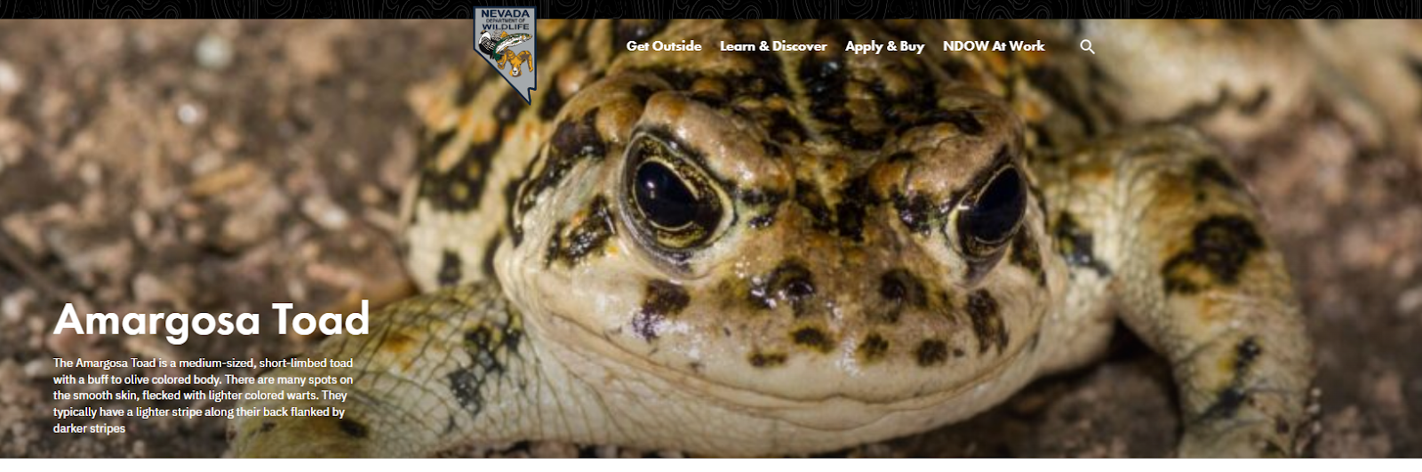
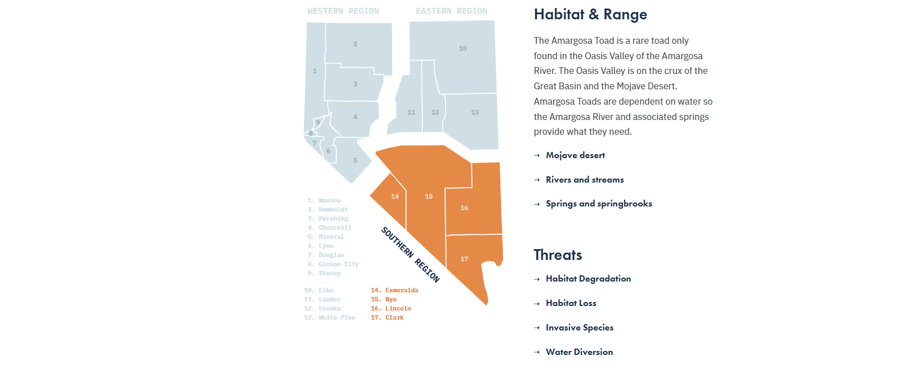
Wildlife Discovery Trail
WEBSITE IMPROVEMENT
Species cards are live online with more species coming with every update
Database Search by species, conservation status, and game status
Species cards showcase habitat & range and threats

Slide 19
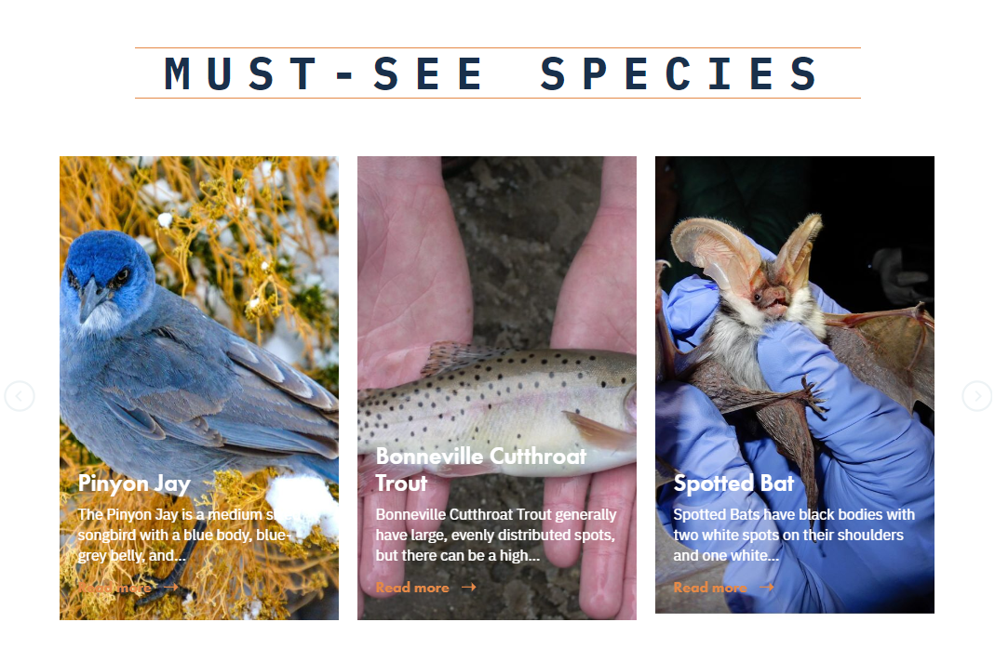
Wildlife Discovery Trail
COMMUNITY ENGAGEMENT
Partnering sites will be able to showcase specific locations or trails
Locations will have physical signage and accessibility ratings for the general public
Planned community science and outreach events
Publications, updated pocket guidebooks, and Discovery Trail physical products planned for development

Slide 20
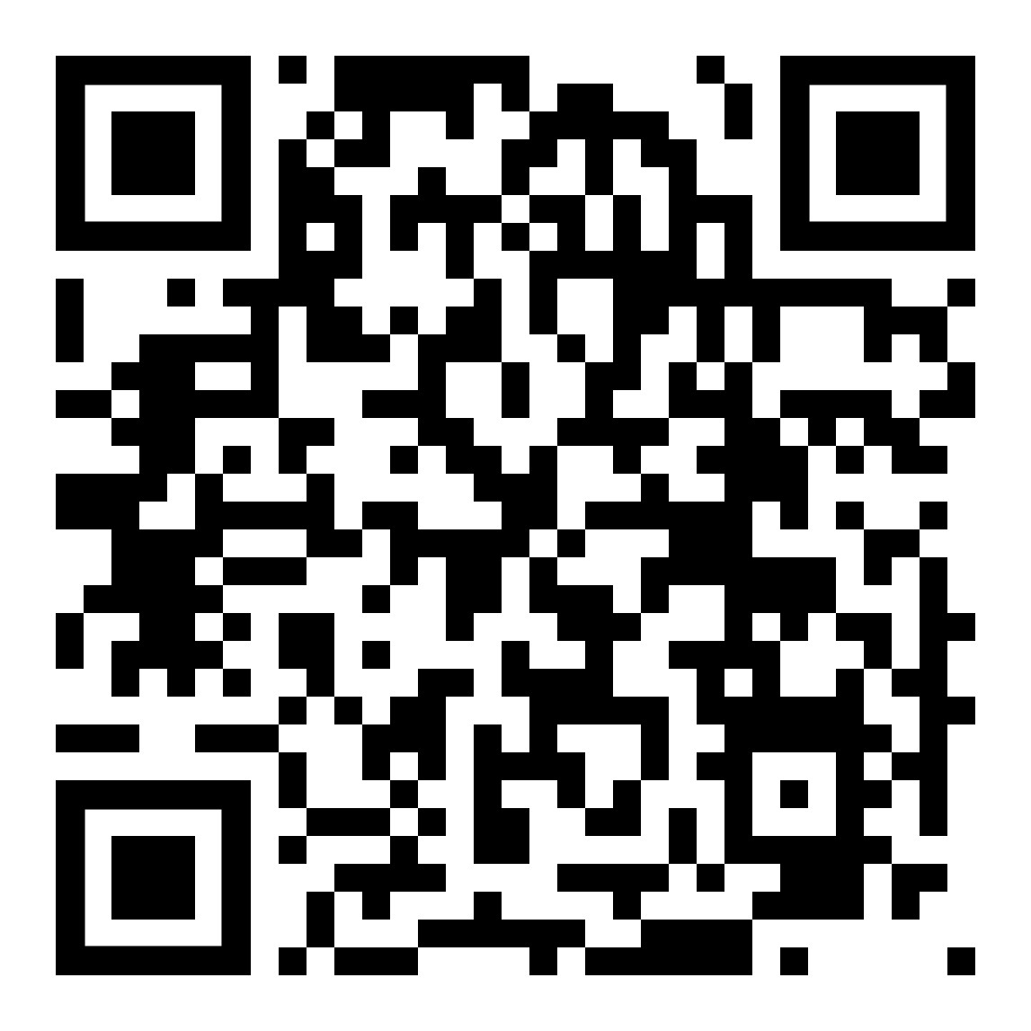
QUESTIONS
Interested in receiving updates?
Contacts us!
Julie Bless jbless@ndow.org
Jess Brooks jdbrooks@ndow.org
Bobby Jones
bsjones@ndow.org
Amargosa Toad species card

Slide 21
Breeding bird surveys

Slide 22
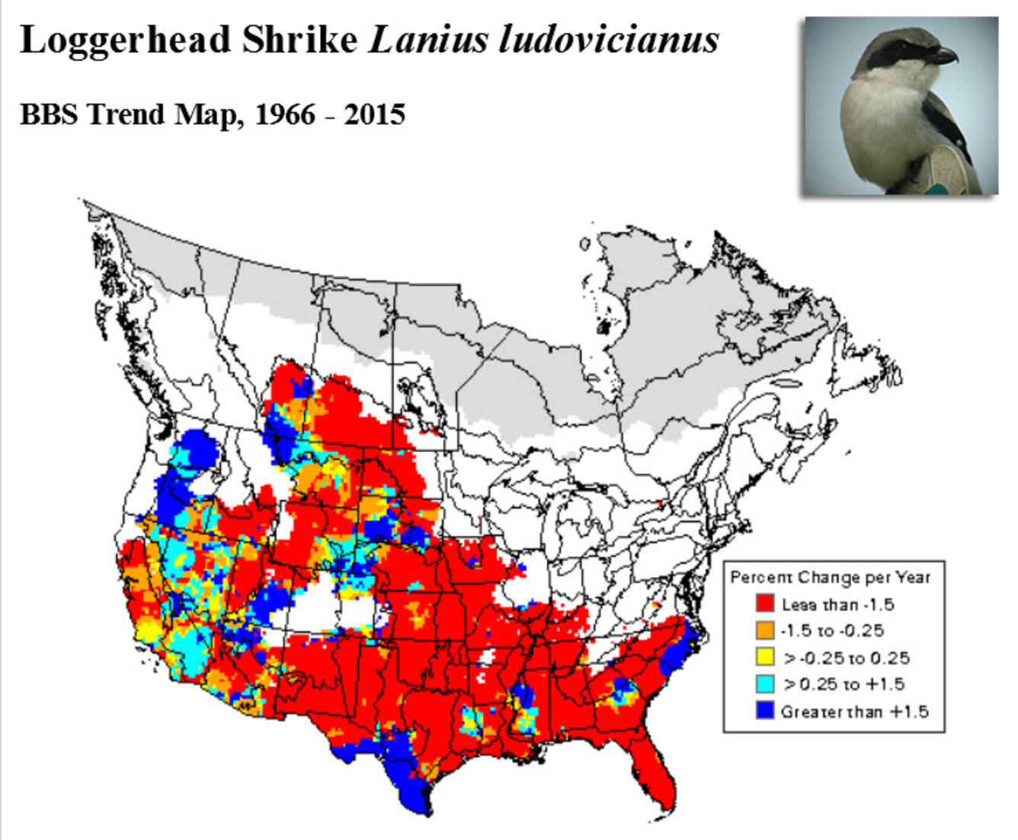
Breeding Bird Survey
OVERVIEW
Rigorous breeding bird population count at designated sites throughout the state (the first breeding bird survey was conducted in 1968)
Over 4,500 routes throughout North America
Each route consists of 50 roadside stops approximately ½ mile apart
All birds detected during a timed period at each stop are recorded (by sound or site)

Slide 23
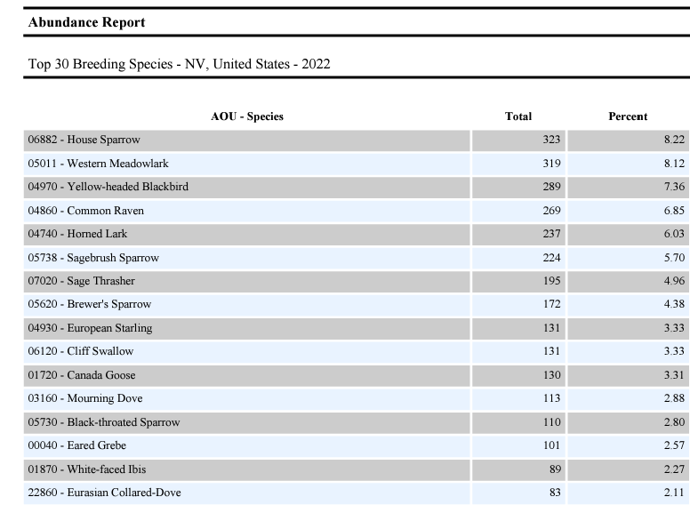
Breeding Bird Survey
2022 UPDATE
29 of the 34 routes were surveyed
3,929 individual birds were recorded (compared to the 6,667 species in 2021; no data in 2020 due to COVID19)

Slide 24
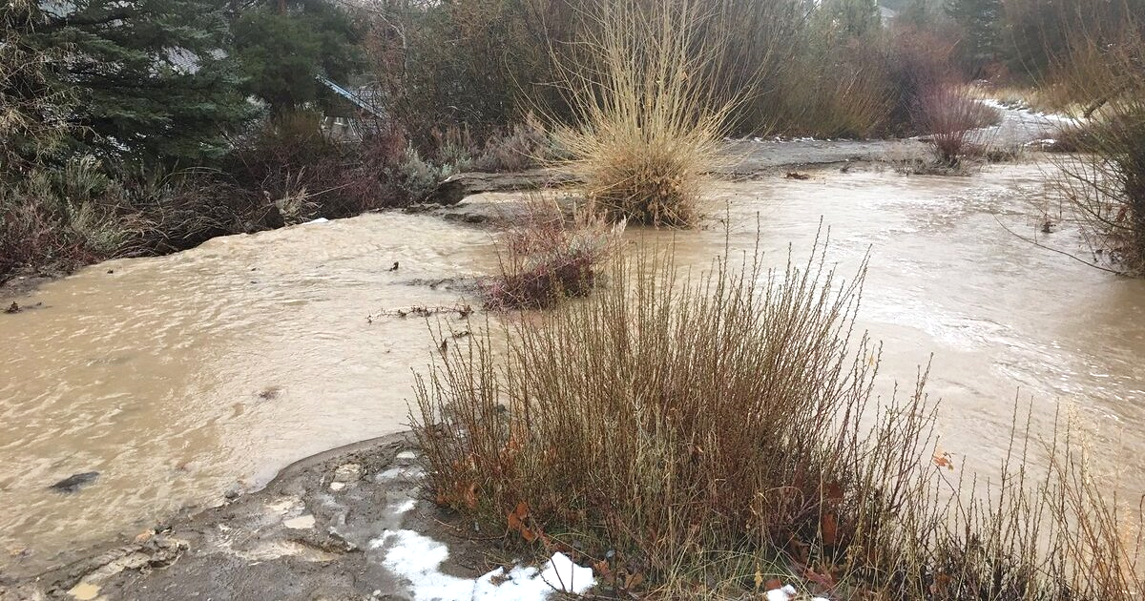
Breeding Bird Survey
2023 UPDATE
With a previous winter with extreme levels of precipitation, surveyors had poor accessibility, washed-out roads, and volatile weather conditions on their survey routes
3 experienced BBS Survey volunteers moved away from the state of Nevada, leaving behind their assigned routes
Most route data has been received but is not available online (as of 9/14/2023)

Slide 25
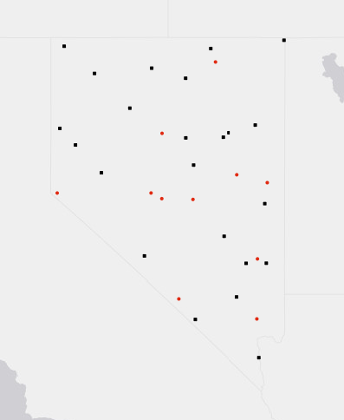
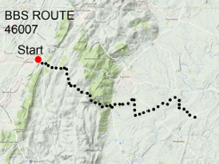
Breeding Bird Survey
Nevada Route update, 2023
34 routes in Nevada
11 routes are currently available
Fish Creek
Toiyabe Nf
Illipah
Majors Place
Dobbin Creek
Caliente
Beatty
Valley of Fire
Charleston Reservoir
Gardnerville (II)
Darroughs Hot Springs
9
1
3
2
4
10
5
11
6
7
8

Slide 26
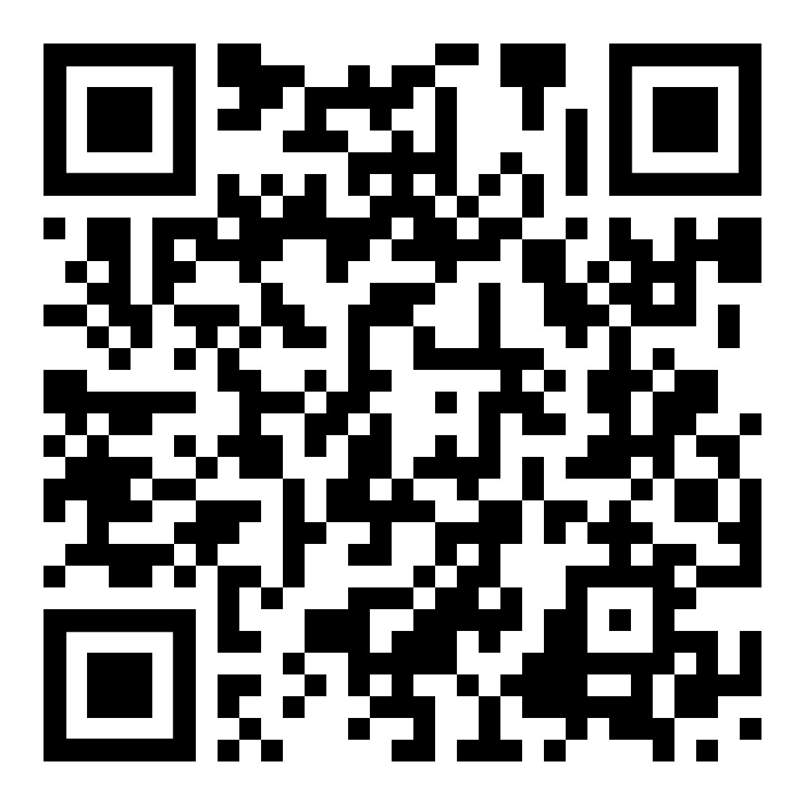
QUESTIONS
Interested in adopting a route?
Contact your state coordinator!
Jess Brooks jdbrooks@ndow.org
Breeding Bird Survey routes

