Slide 1
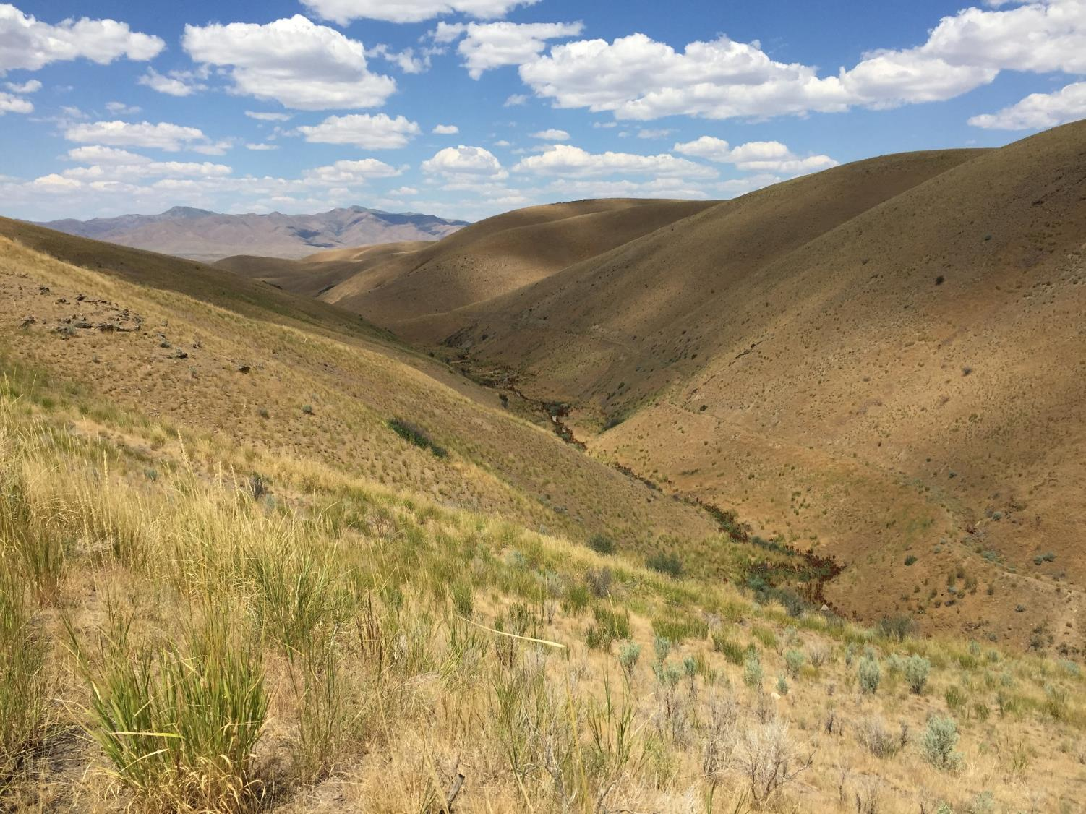
Nevada Partners for Fish and Wildlife Program
Christiana Manville and Susan Abele
U.S. Fish and Wildlife Service, Reno, Nevada
Notes:
Thank you so much for the opportunity to come over and share a bit about what we have going on in Nevada. I know most of you but my name is Susan Abele, and I’m the State Coordinator for the Partners Program in Nevada. I am based in the Reno Fish and Wildlife Office which is an Ecological Services office. I have prepared some slides to share with you a bit about the state of Nevada, the Great Basin, and the work we have been doing with private landowners.

Slide 2
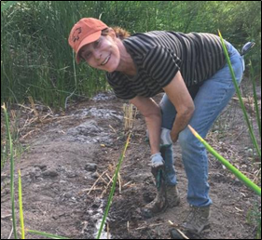
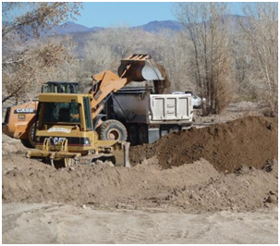
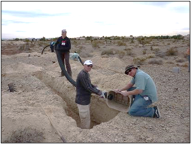
Partners For Fish & Wildlife Program
Implement voluntary, habitat restoration projects on private and tribal lands
Provide funding and technical assistance to landowners and other partners
Collaboration
Notes:
Funding is cost-share

Slide 3
Landownership and Uses
>86% public lands
Major industries include gaming, tourism, mining, and manufacturing.
Public lands also support recreation, hunting & fishing, and livestock grazing.
Disproportionate importance of private land to wildlife, especially water associated species
Notes:
Without question, Nevada is a public lands state. We have over 86% publicly managed lands. The Bureau of Land Management and U.S. Forest Service, along with the military, are the major land managers. We also have 9 Wildlife Refuges.
Major industries include gaming, tourism, mining and manufacturing. Nevada produces the most gold in the country and is 4th in the world.
Public lands also support recreation, hunting & fishing, and livestock grazing.

Slide 4
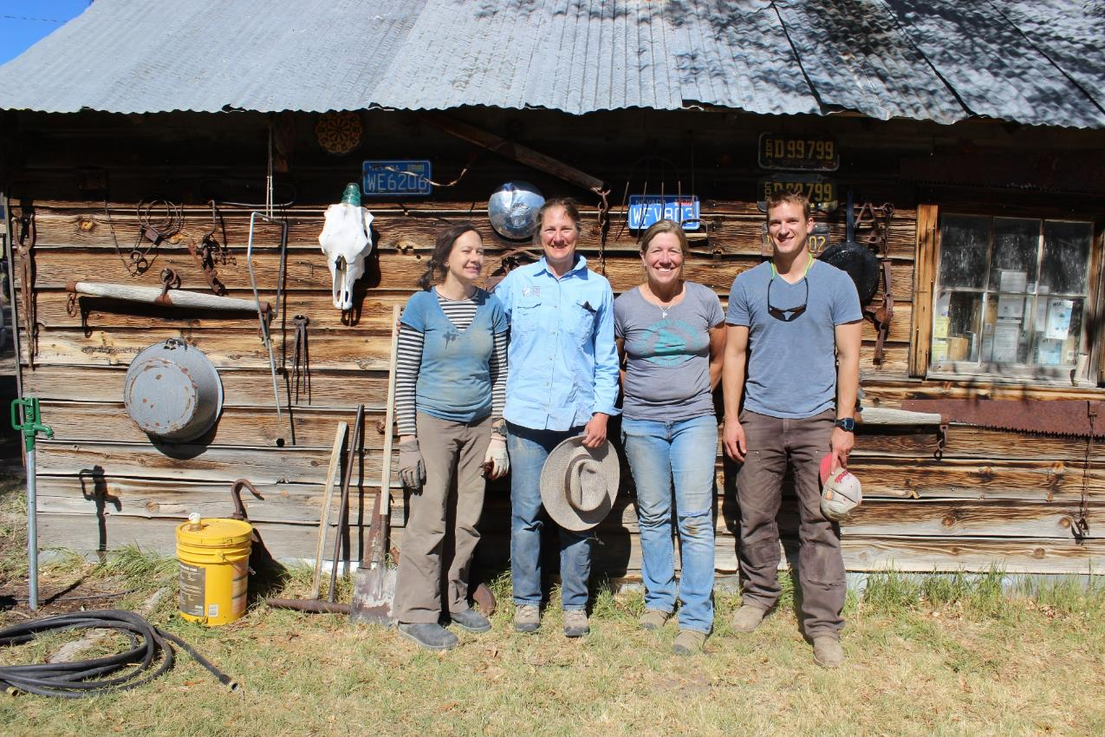
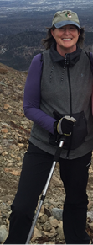
Nevada Partners for Fish and Wildlife
Michelle Hunt
Reno
Susan Abele
Reno
Cheryl Mandich
Winnemucca
Christiana Manville
Las Vegas
William Kutosky
Elko
Notes:
The crew in Nevada includes four of us fully funded by PFW. Christiana Manville is based in the Southern Nevada FWO in Las Vegas. I am in Reno and William Kutosky is our PFW biologist in Elko which is in northeast Nevada. Michelle Hunt is a shared employee with ES in Reno and much of her work has included Connecting People with Nature and youth engagement through schoolyard habitats or outreach events.

Slide 5
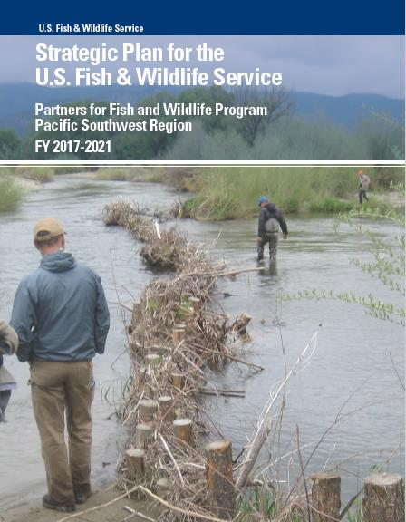
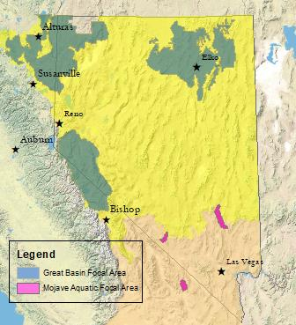
Strategic Plan (2017 – 2021) Great Basin Landscape Targets
“80”
Sagebrush uplands
Wet meadows
Intermountain rivers and streams
“20”
Endemic aquatic species
Pollinators/Monarchs
Flood irrigated meadows
Notes:
In our most recent Strategic Plan, we have set objectives and performance metrics for what we have called landscape targets which include sagebrush uplands, wet meadows, intermountain rivers and streams, endemic aquatic species, pollinators/monarchs, and flood irrigated meadows. I have binned our efforts into what we are spending 80% of our time on versus the 20% and our performance metrics represent that.

Slide 6
Secretarial Order 3362 (SO 3362) Feburary 9, 2018
Notes:
We were rolling along with our work when out came our new priority from the Secretary. This map represents the Great Basin, Mojave Desert, and other Region 8 PFW focus areas. On top of that are the priority areas identified in the State Action Plans for SO 3362. You can see in Nevada that none overlap the Mojave Focus Area but there is quite a bit of overlap with the Great Basin Focus Area. Fortunately, our Elko biologist is collocated with the Nevada Department of Wildlife and we were poised to develop some good project proposals for the FY19 funding that was available through Headquarters.

Slide 7
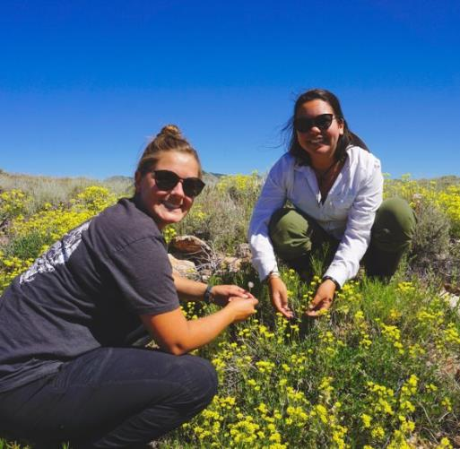
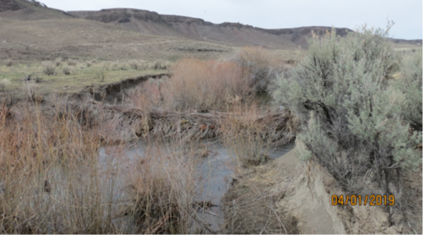
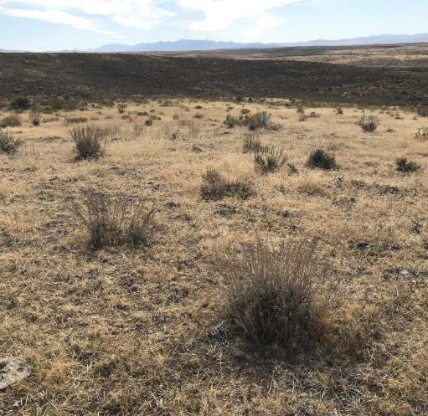
Great Basin Project Examples
Notes:
I thought I’d highlight a few things we are doing that are more novel, at least for what we’ve typically done in Nevada.
I just mentioned this work on the previous slide. In NE NV, we are working with a private landowner, NDOW, and the Forest Service to treat medusahead which is one of our nasty invasive annual grasses. We are using a new herbicide that has shown, in small trials, promising results. [fill in rest from William]

Slide 8
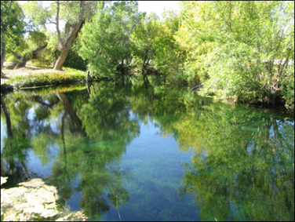
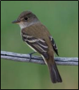
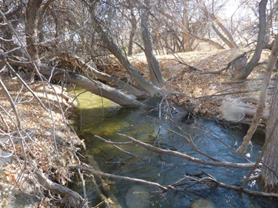
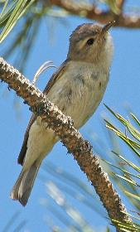
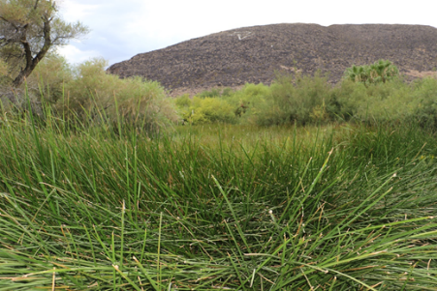
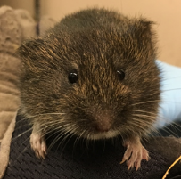
Strategic Plan (2017 – 2021)
Mojave Desert Landscape Targets
“80”​
Isolated Springs and Springbrooks
Desert Ciénagas
Mojave rivers and streams​
​
“20”​
Pollinators/Monarch
Urban and Ag. Desert Scrub

Slide 9
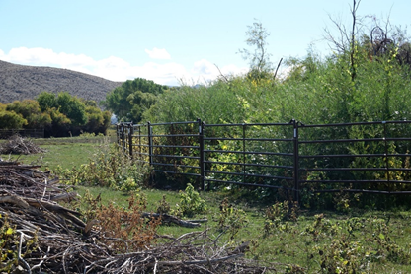
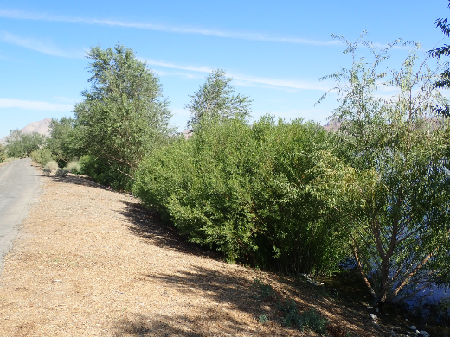
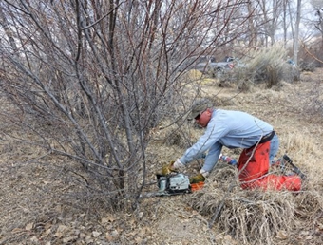
Mojave Desert Project Examples
Fencing riparian breeding habitat for endangered birds
Riparian plantings to improve bird habitat
Invasive Species Control
Notes:
I thought I’d highlight a few things we are doing that are more novel, at least for what we’ve typically done in Nevada.
I just mentioned this work on the previous slide. In NE NV, we are working with a private landowner, NDOW, and the Forest Service to treat medusahead which is one of our nasty invasive annual grasses. We are using a new herbicide that has shown, in small trials, promising results. [fill in rest from William]

Slide 10
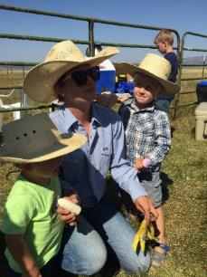
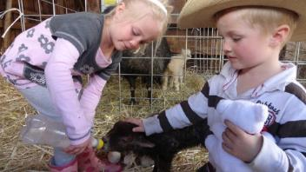
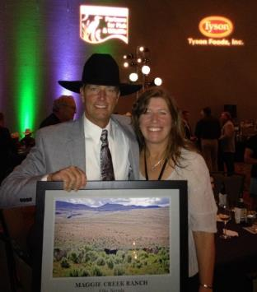
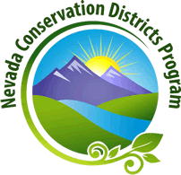
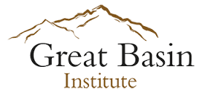
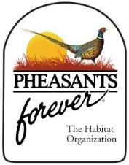
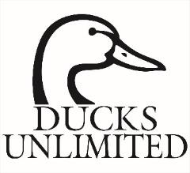
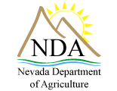
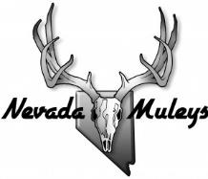
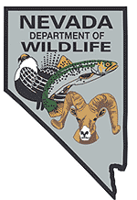
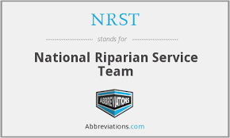
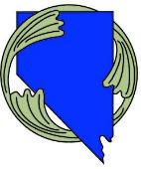
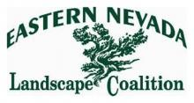
Partnerships
Notes:
Our private landowners are our number one partner! It’s not a large community but we do have a lot of good partnerships in Nevada. Over the 8 years I’ve been here, we are collaborating more and more on projects and I hopeful this will continue into the future.

Slide 11
How NV PIF Can Help
Share interested private landowner contacts
Project ideas on private land
Help with monitoring, PFW cannot pay for monitoring
Often looking for new partners for more funding or resources

Slide 12
Nevada Contacts
Susan Abele
Reno, NV
Cell: 775-742-8884
Email: susan_abele@fws.gov
https://www.fws.gov/reno/
William Kutosky Elko, Nevada
Cell: 720-930-1375
Email: william_kutosky@fws.gov
Cheryl Mandich
Winnemucca, NV
Cell: 775-447-0818
Email: cheryl_mandich@fws.gov
Christiana Manville
Las Vegas, NV
Cell: 702-271-6173
Email: Christiana_Manville@fws.gov
National Program Website
https://www.fws.gov/partners/

