Slide 1
U.S. Fish & Wildlife Service Region 8
Golden Eagle Breeding Survey Interim Recommendations
Photo: USFWS stock
Sep. 15, 2023

Slide 2
Justification and Need
National FWS guidance available, but not with fine scale considerations
Pagel et al. 2010. Interim Golden Eagle Inventory and Monitoring protocols
USFWS. 2013. Eagle Conservation Plan Guidance: Module 1 – Land-based wind energy
Other appropriate documents to consider
Driscoll. 2010. Protocol for Golden Eagle occupancy, reproduction, and prey population assessment
NVMA. 2018. Golden Eagle Protection Best Practices
Existing guidance led to highly variable survey approaches with inconsistent data at times unable to support project effects evaluations (e.g., NEPA) in NV
A standardized approach based on local GOEA breeding biology:
Improves our ability to assess potential/existing project impacts
Improves our ability to assess impacts within projects over time, between projects, and across project types
Improves certainty for agencies, project proponents, and consultants

Slide 3
Justification and Need
Common problems related to non-standardized survey approach, inconsistent survey effort, or survey effort not in sync with local GOEA breeding biology
Routine confusion relating to nest vs. territory occupancy
Consistently underestimated territory occupancy leads to underestimation of project area population (i.e., number of potentially impacted GOEA territories)
Unknown project area population hinders ability to ensure GOEA conservation, estimate potential take probability, calculate mitigation needs, etc.
Complicates direct use of annual raptor survey reports for project area tracking, development of Eagle Conservation Plans, or to support development of incidental eagle disturbance take permit
Standardized survey efforts are needed to assess impacts to GOEA project area population from large-scale habitat development, loss of home range and foraging area, and reduction in prey base

Slide 4
Golden Eagle Breeding Season & Survey Timing
Breeding Season = 15 December – 31 July (i.e., courtship, incubation, nestling, post-fledgling stages)
Minimum post-fledgling dependence period = 4 weeks after fledging
Mean annual Initiation of Incubation (eggs laid) = 22 February (27 Jan. – 6 Apr.)
15 April = Date GOEA nests considered not in-use if not already verified in-use
Mean annual Fledging Date = 12 June (20 May – 14 Jul.)
Preferred Survey Windows:
GOEA ground surveys for territory occupancy: January – February (extend to mid-March at high elevations and high snow years)
GOEA aerial surveys for territory occupancy and nest use: February – mid-March
Territory occupancy/nest use follow-up/all raptors: March – mid/late-April
GOEA Productivity/all raptors: late May – June
Recommended Disturbance Buffers:
Breeding Season (15 Dec. – 31 Jul.), or until 15 Apr. if nests are confirmed not in-use
1-mile spatial buffer for industrial, municipal, and construction activity
2-mile spatial buffer for blasting activity

Slide 5
Survey Type Considerations
Ground Surveys
Preferred method for assessing early season territory occupancy (area based)
Require a comprehensive nest/territory inventory
Nest inventory generally obtained aerially on new projects, multi-year projects can rely on previous years’ monitoring to guide ground surveys in subsequent years
Dependent on logistics and landscape accessibility
Up to 4-hour observation period, or until essential information is obtained
Observational criteria used for early season GOEA territory occupancy identified in the recommendations (area-based)

Slide 6
Survey Type Considerations
Aerial Surveys
Preferred method to develop project area nest inventory (point/linear based)
Not designed to effectively determine early season territory occupancy
Can be ideal for assessing nest contents
Are sometimes the only alternative depending on survey area size and accessibility
Can cause disturbance within bighorn sheep lambing habitat
Consult NDOW for sensitive areas and timing considerations
Strive to minimize potential impacts when timing and survey areas overlap
Observational criteria used for early season GOEA nest in-use status in the recommendations (nest site-based)

Slide 7
Survey Objectives
Nest Inventory
First step in baseline survey effort
Useful to direct future survey efforts
Can be conducted any time of year if not concerned with territory occupancy/nest use
Can be combined with territory occupancy/nest use surveys if timing occurs with GOEA courtship/early incubation period
Inventory survey should cover all suitable nesting habitat (e.g., cliffs, rocky outcrops, transmission lines, and/or trees as appropriate)
Bighorn Sheep Lambing Season (NVMA 2018; subject to site-specific considerations)
Southern Nevada: 1 January – 31 March
Central Nevada: 1 February – 30 April
Northern Nevada: 1 April – 31 May

Slide 8
Survey Objectives
Territory Occupancy Survey
Initial occupancy survey conducted during courtship/incubation (Jan. – mid-Mar.)
Follow-up occupancy survey conducted at least 30 days following initial survey (Mar. – mid-Apr.)
Territories should be considered occupied in a given year unless the initial and follow-up surveys yield negative results
Follow-up surveys are essential for determining use status of GOEA nests early in the breeding season
Essential for subsequent breeding success and productivity assessment
Useful when considering other diurnal raptor species which breed later than GOEAs

Slide 9
Survey Objectives
Productivity Survey
Targeted for when GOEAs have late-stage nestlings to assess breeding success and productivity (i.e., ≥51 days old; note that the protective disturbance buffers should remain 4-weeks post-fledging through the post-fledging dependency period)
Beneficial for supporting any needed NEPA analyses
Helps contextualize project area population status, prey and habitat conditions
Are often important for assessing potential project impacts to breeding GOEAs and may be a required incidental eagle disturbance take permit condition
May be useful for also assessing breeding status of other later-nesting raptor species (e.g., ferruginous hawks)

Slide 10
Development Type
Operational Mines & Solar Energy
≥ 2 years of baseline GOEA surveys prior to commencement of project activities and substantial project expansion
Survey suitable habitat within project area to 10 miles surrounding the project area for baseline
In most cases survey area reduces to 4 miles surrounding the project area after two year baseline (2 miles for underground mine projects)
Exploratory Mining
2 years of preconstruction baseline surveys out to a 2-mile area around large exploration projects (e.g., no acreage limits, disturbance over ≥2 years, utilize blasting; 1 year and 1 mile survey area for small projects <5 acres)
Geothermal Energy Projects
At least 1 year of baseline GOEA surveys prior to resource confirmation drilling and 2 years prior to construction of energy production facilities
Survey suitable habitat within project area to 2 miles surrounding the project area
Electrical Transmission Lines
1-mile survey area around project area

Slide 11
Development Type
Wind Energy Projects
Risk assessments to GOEAs within wind energy project areas are weighted heavily by information gathered from fixed-radius large bird (including eagles) point counts (USFWS 2013)
In addition to predicting eagle fatalities (USFWS 2013), impact evaluations are improved with other project-area surveys prior to development, and can lead to developing alternatives for NEPA analysis
We recommend evaluating the broad geographic area to assess relative importance to resident, migrant, and wintering eagles:
At least 2 years of baseline GOEA surveys prior construction
Survey all suitable habitat within 2 miles of the project-area, although site-specific considerations may lead to greater survey distance recommendations

Slide 12
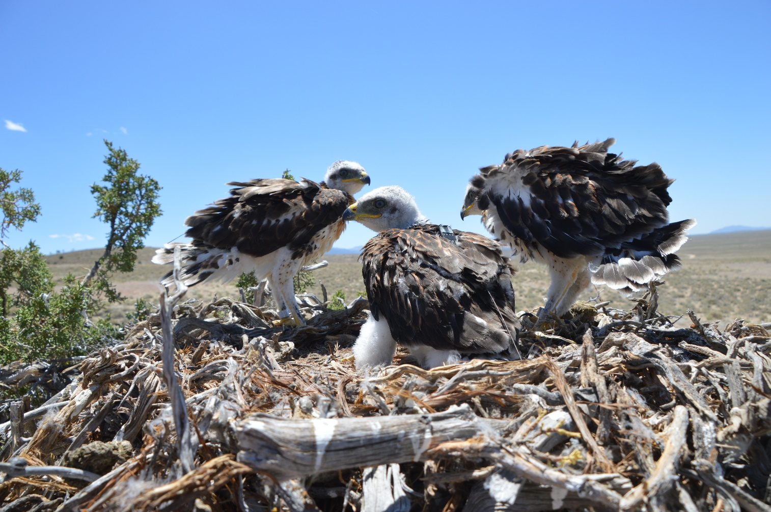
Ferruginous Hawk Monitoring and Habitat Use

Slide 13
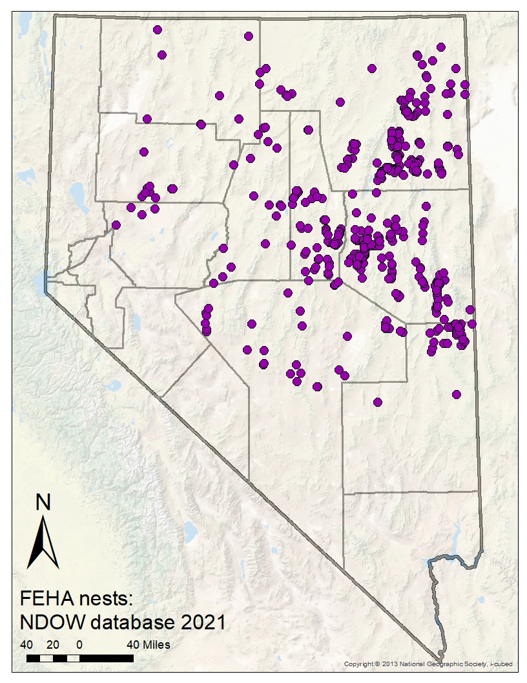
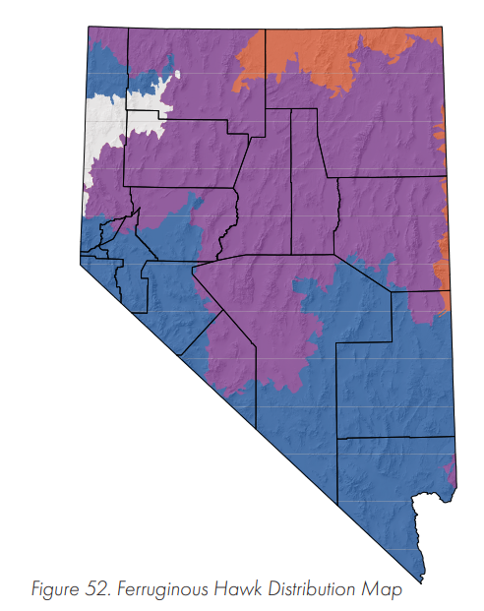
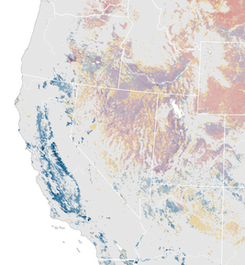
Distribution of Nests
Confirmed FEHA Nests in NDOW Database: 1974–2021 (n = 667)

Slide 14
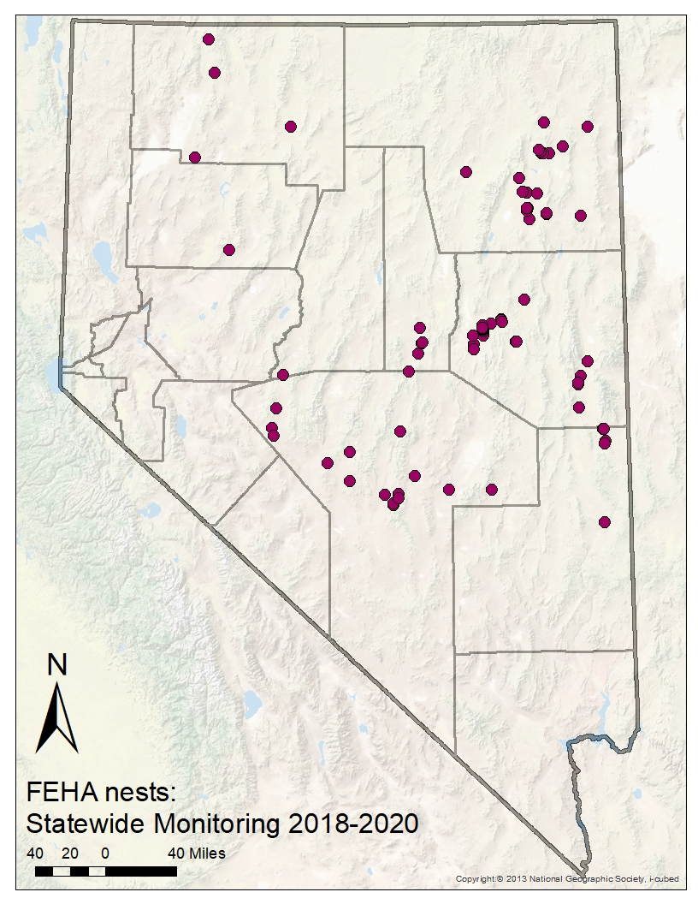
Distribution of Nests
Confirmed FEHA Nests in NDOW Database: 1974–2021 (n = 667)
FEHA Nests in Statewide Monitoring: 2018–2020 (n = 89)
Territory Monitoring (1999–2023)
Statewide = 27
Central/Northeast = 41
Northwest = 70

Slide 15
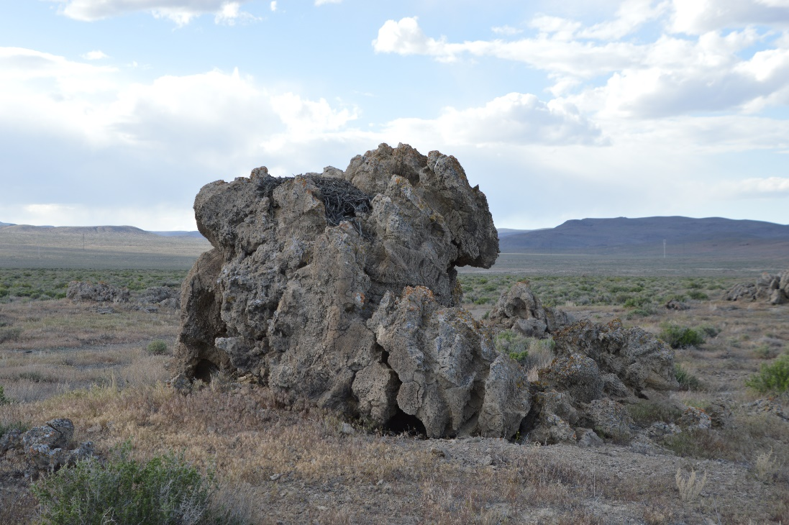
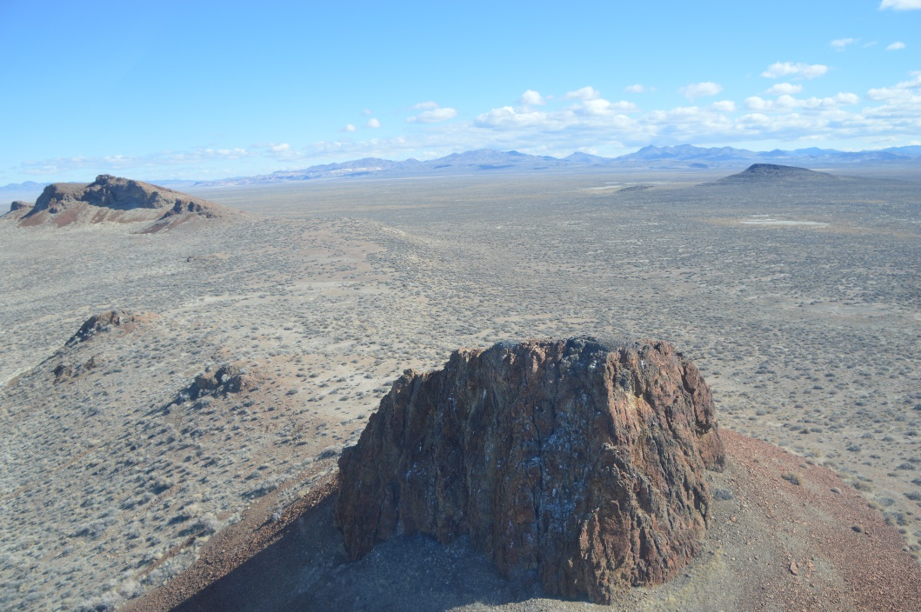
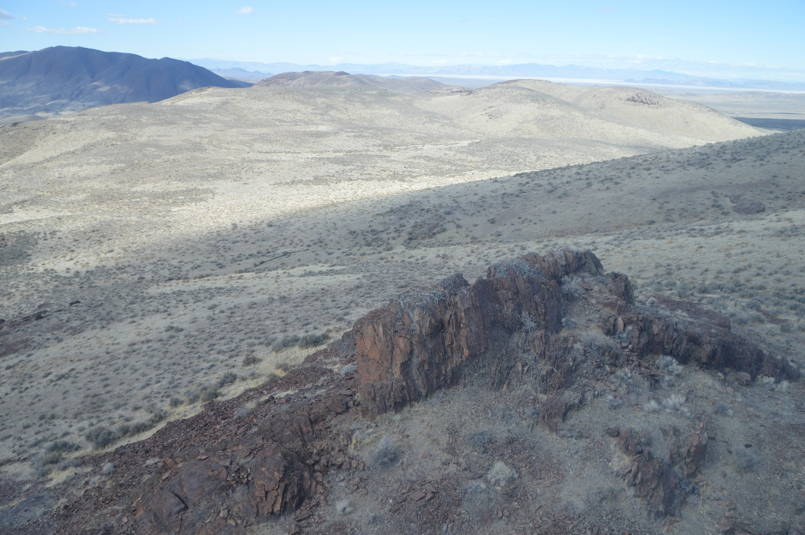
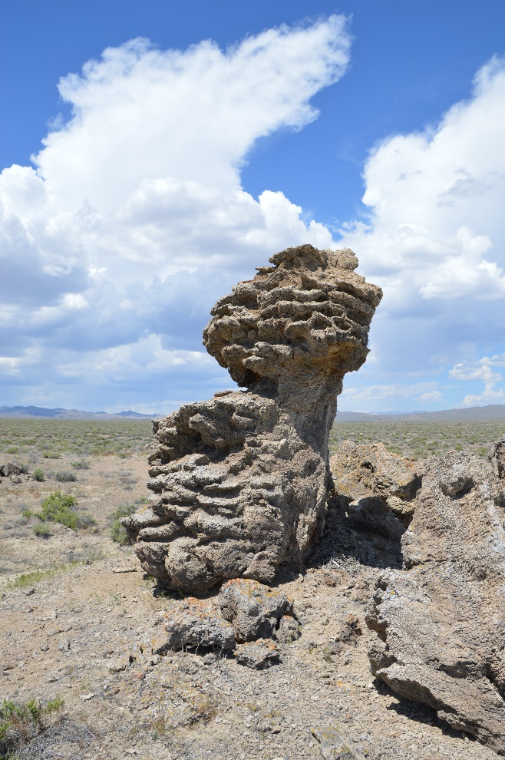
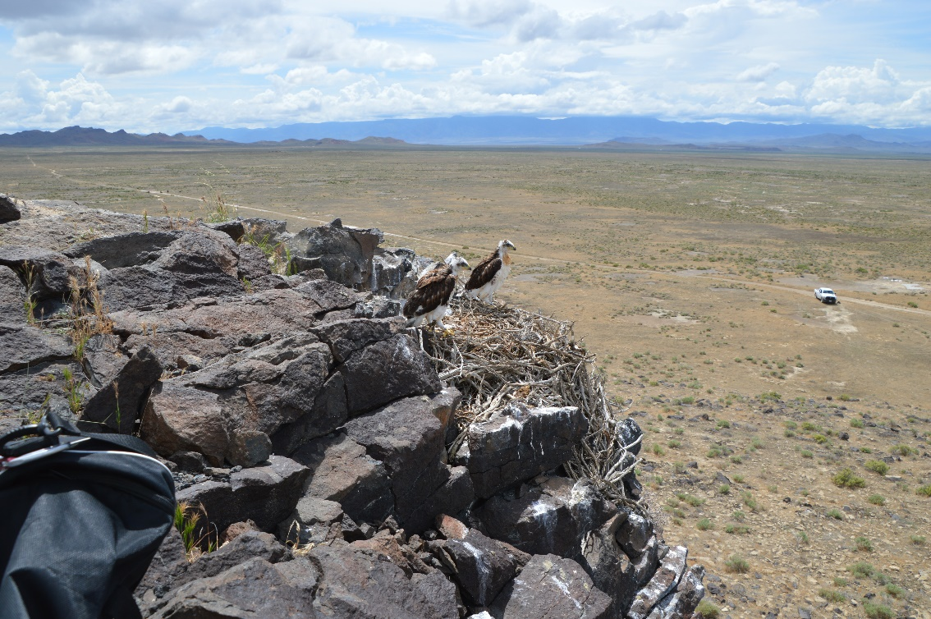
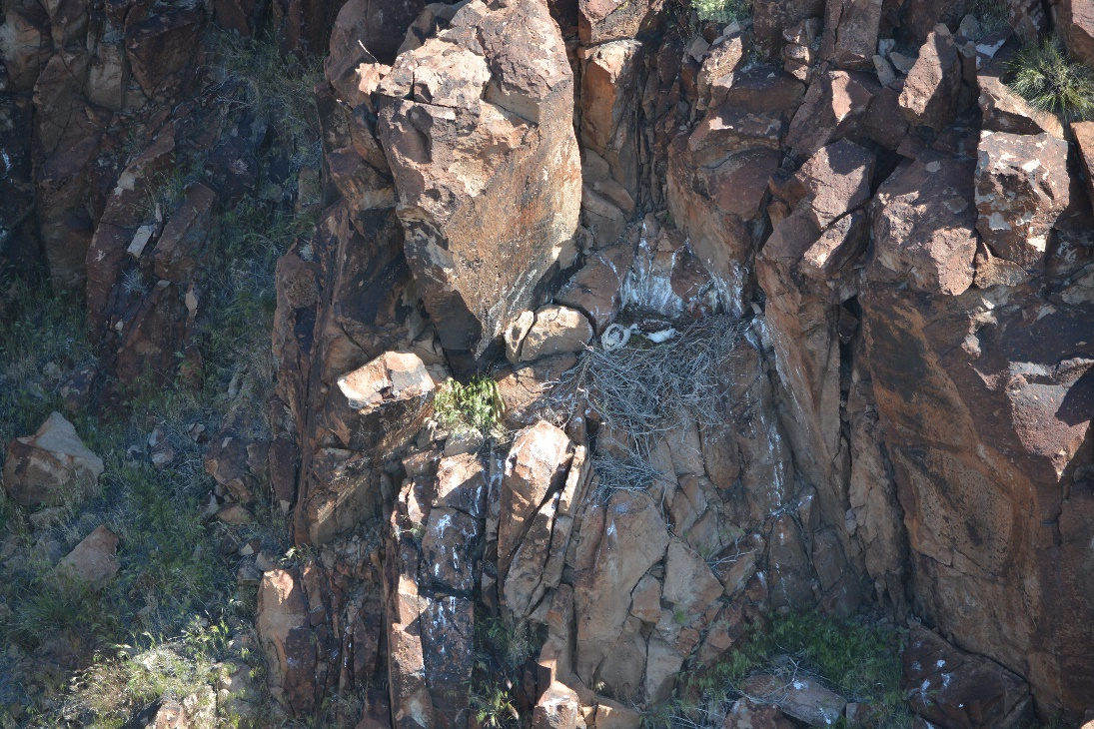
Nest Site Comparison
Northwest

Slide 16
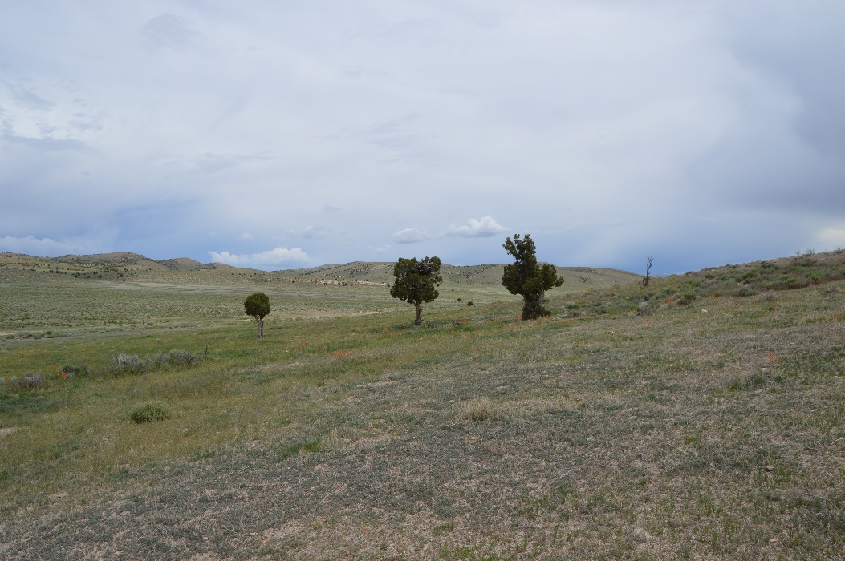
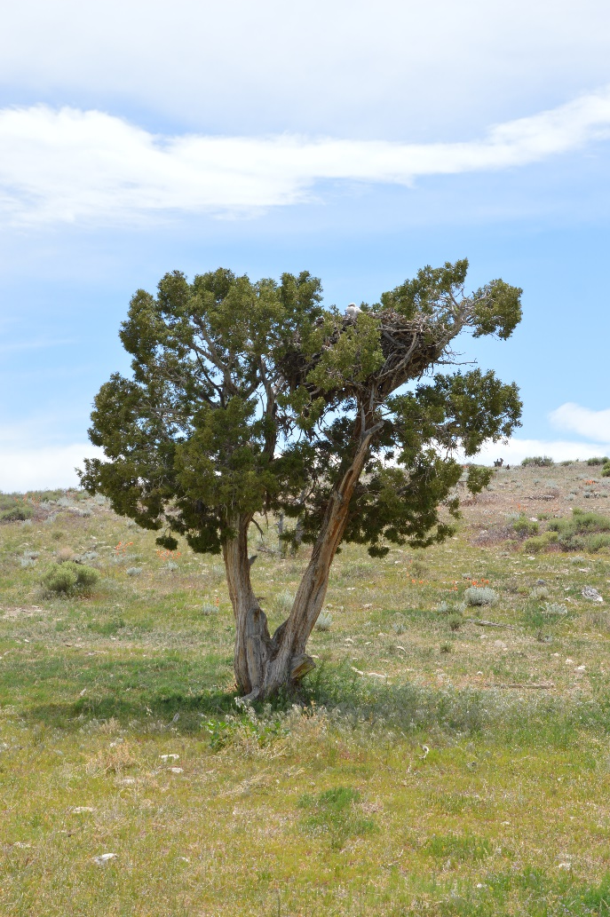
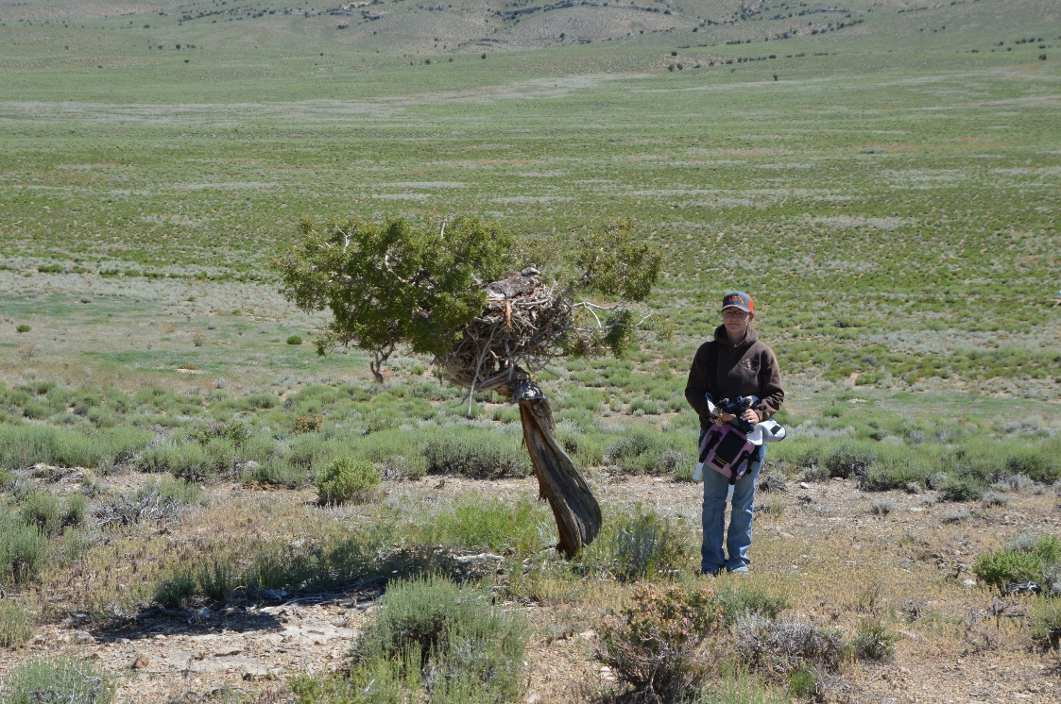
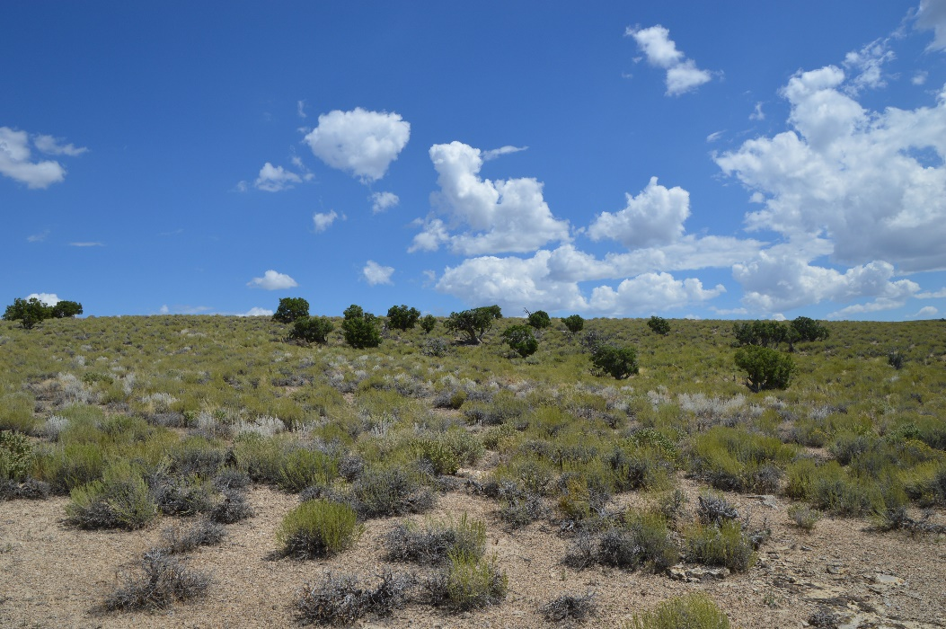
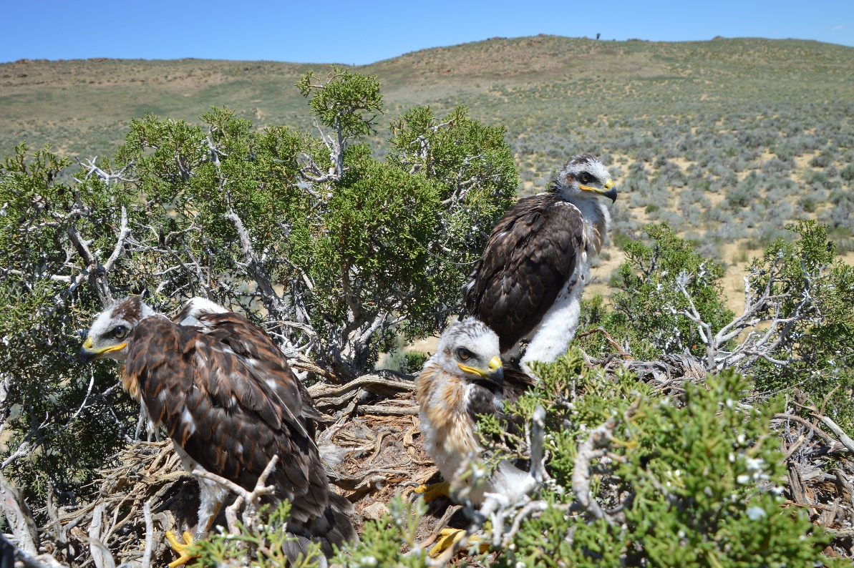
Nest Site Comparison
Central/Northeast

Slide 17
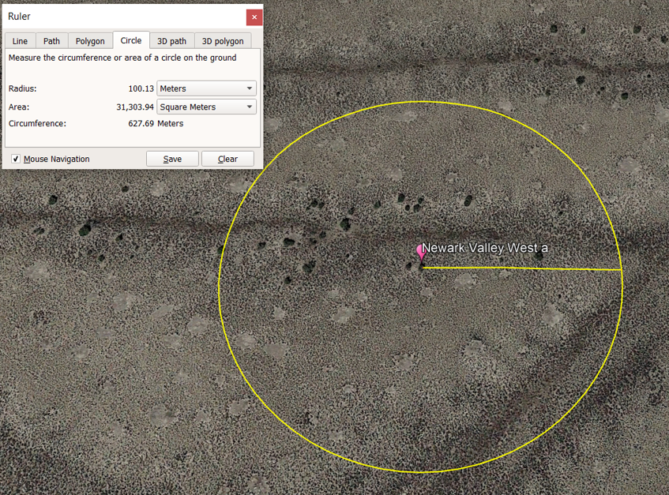
Tree Density: Pinyon-Juniper Woodland
100 m radius around nest tree (≥1.5 m)
Mean 10.1 tree/ha (SD = 9.5)
33 of 51 tree densities greater at 100-m radius than 500-m radius
Mean 15.1 m to nearest tree
Mean Nest Height: 3.1 m (n = 39)

Slide 18
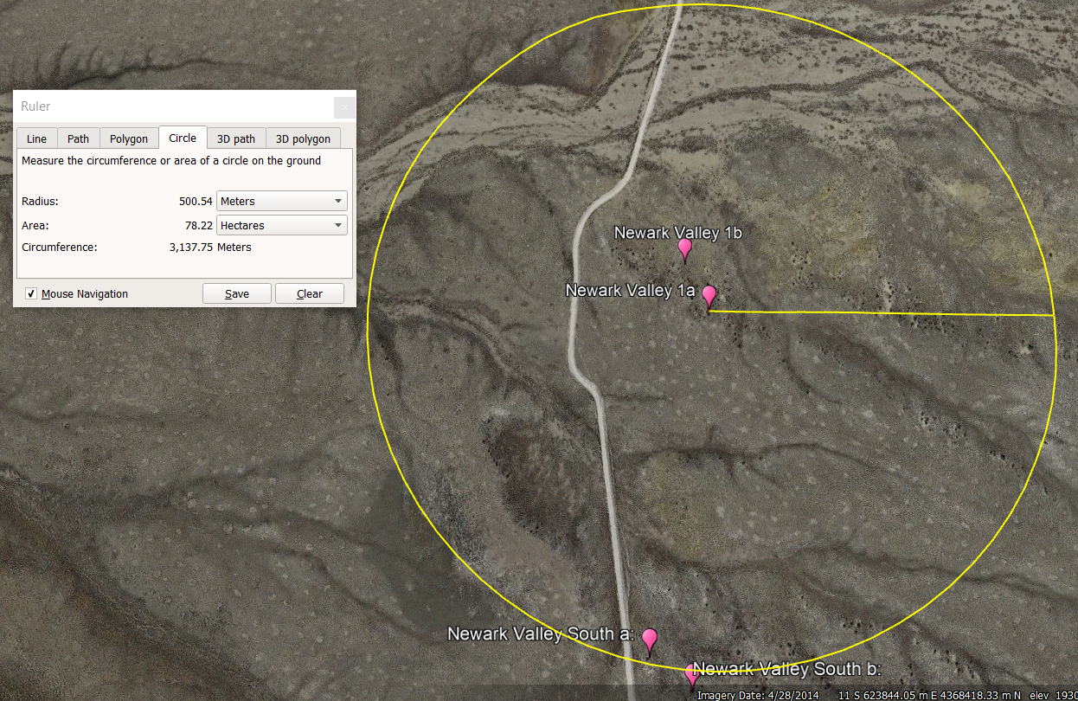
Tree Density: Pinyon-Juniper Woodland
100 m radius around nest tree (≥1.5 m)
Mean 10.1 tree/ha (SD = 9.5)
33 of 51 tree densities greater at 100-m radius than 500-m radius
Mean 15.1 m to nearest tree
Mean Nest Height: 3.1 m (n = 39)
500 m radius around nest tree
Mean 6.7 tree/ha (SD7.2)

Slide 19
Annual Territory Occupancy

Slide 20
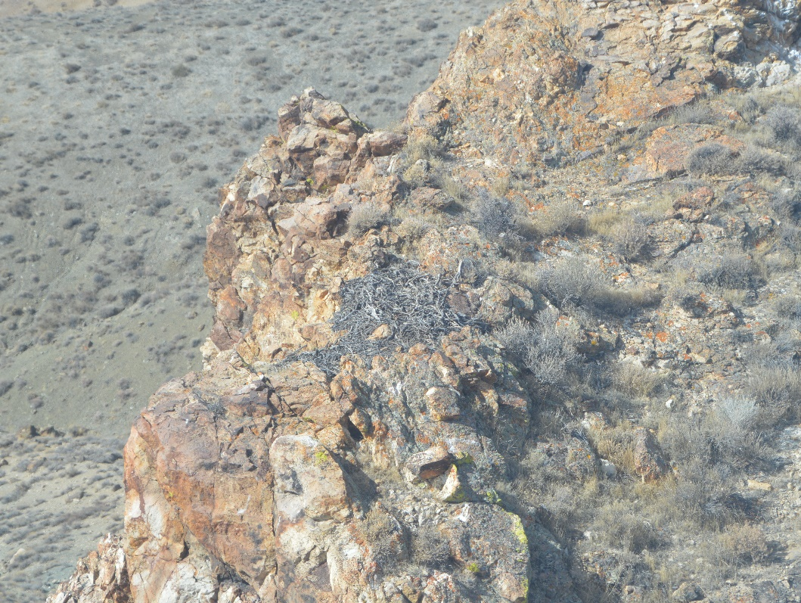
Territory Persistence
Northwest (1999–2023; mean 23.1 territories/year; range 7–60)
Territory Occupancy Overall = 28.2% (n = 578)
Long-term Monitoring: 26 of 38 territories abandoned (78.3%)
Central/Northeast (2017–2023; mean 27.7 territories/year; range 3–39)
Territory Occupancy Overall = 82.5% (n = 194)
Long-term Monitoring: 1 of 21 territories abandoned (4.8%)
Statewide Effort: 83% of previously known territories currently occupied (mean = 17 years since initial discovery; range 4–42 years)

Slide 21
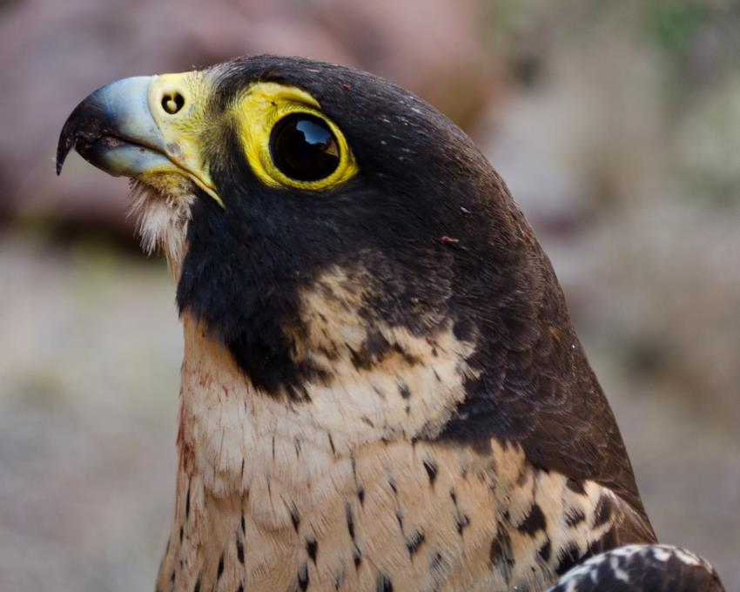
Peregrine Falcon Statewide Territory Occupancy Assessment: 2024

Slide 22
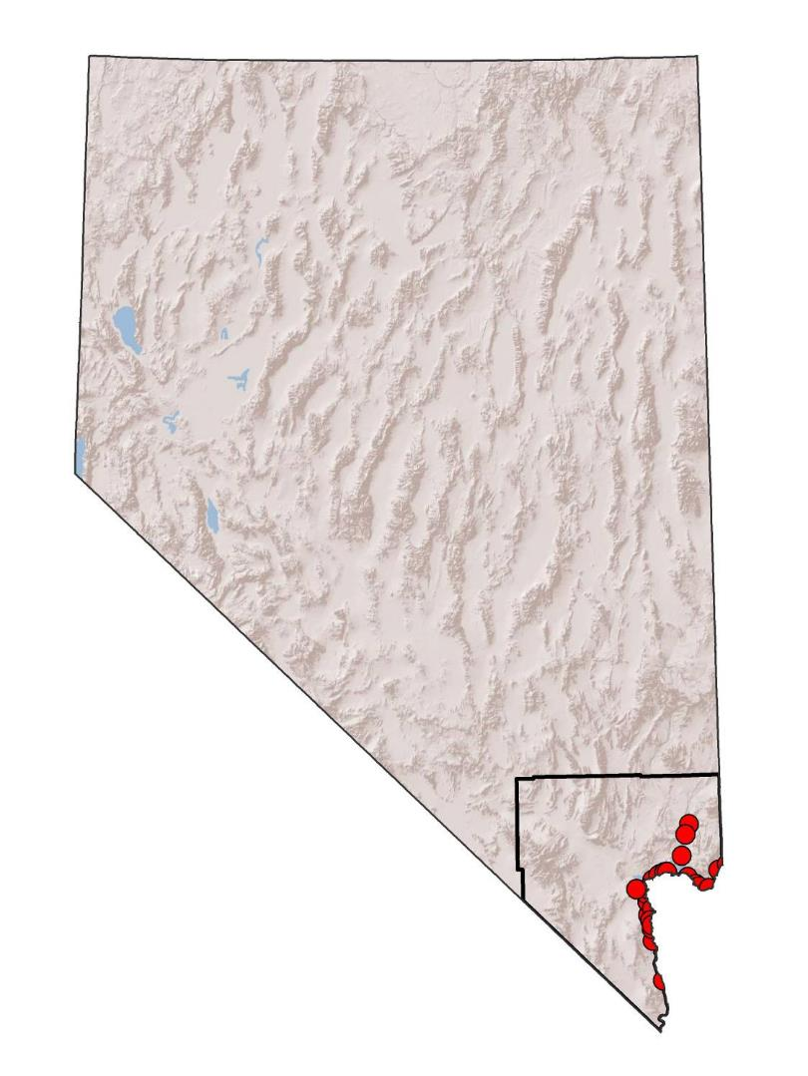
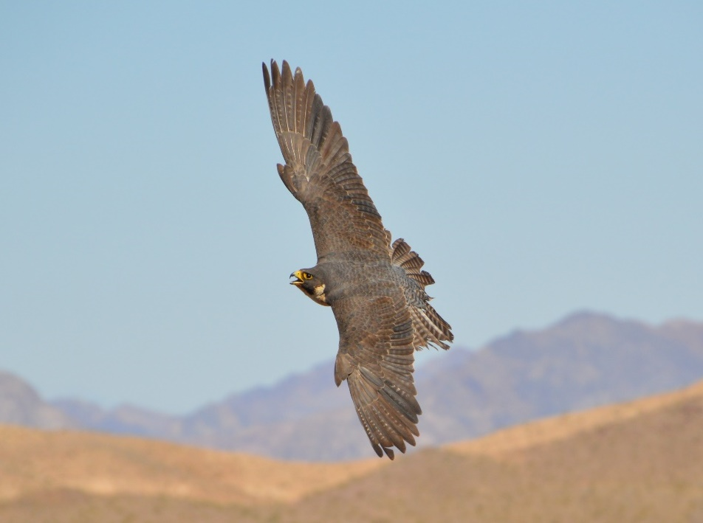
Known Nevada Territory Distribution
Pyramid Lake
Ruby Mts.
Reno
Clark County
Known Territories: 2019
Territory in LMNRA
(41)
Territory outside LMNRA
(45)
Notes:
Current situation is quite different with an increasing population in southern NV which appears to be expanding northward into more arid mountain ranges not previously inhabited. In particular, I’ll be talking to you about the population just outside Las Vegas in Lake Mead National Recreation Area. The NV Department of Wildlife conducts annual aerial surveys across large portions of the rest of the state, but there is a LOT of open space out there…

Slide 23
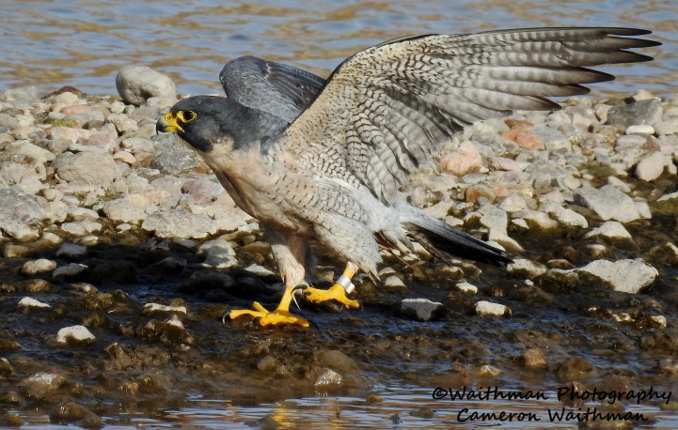
Peregrine Territory Occupancy in Nevada
94% Occupancy; n = 145
77% Occupancy; n = 110
Includes NDOW and NPS survey efforts

Slide 24
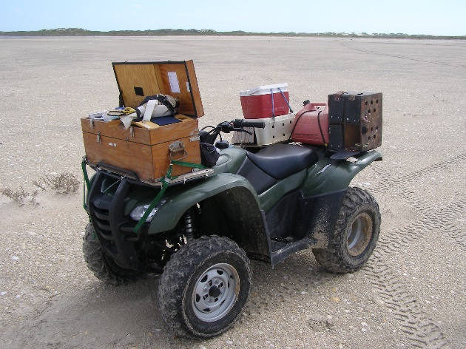
Trends Elsewhere
Yukon River, AK Monitoring & South Padre Island, TX fall migration surveys

Slide 25
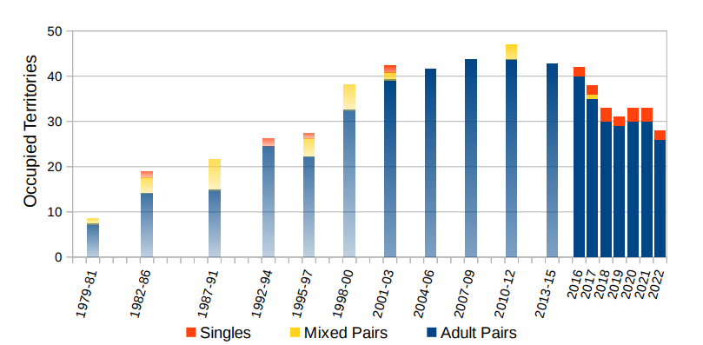
Trends Elsewhere
New Mexico Annual Monitoring: Johnson et al. 2022

